Slide 1
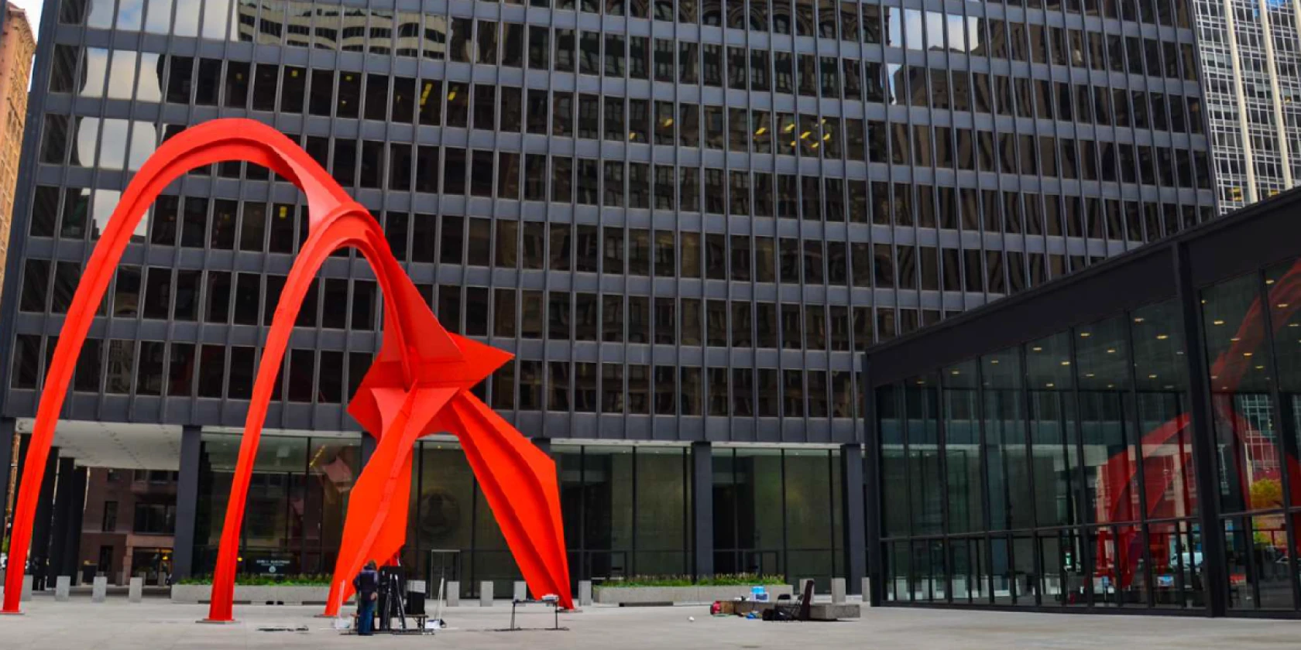
Notes:
Alexander Calder

Slide 2
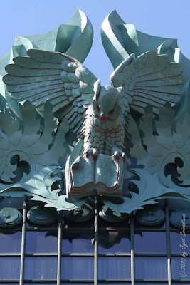
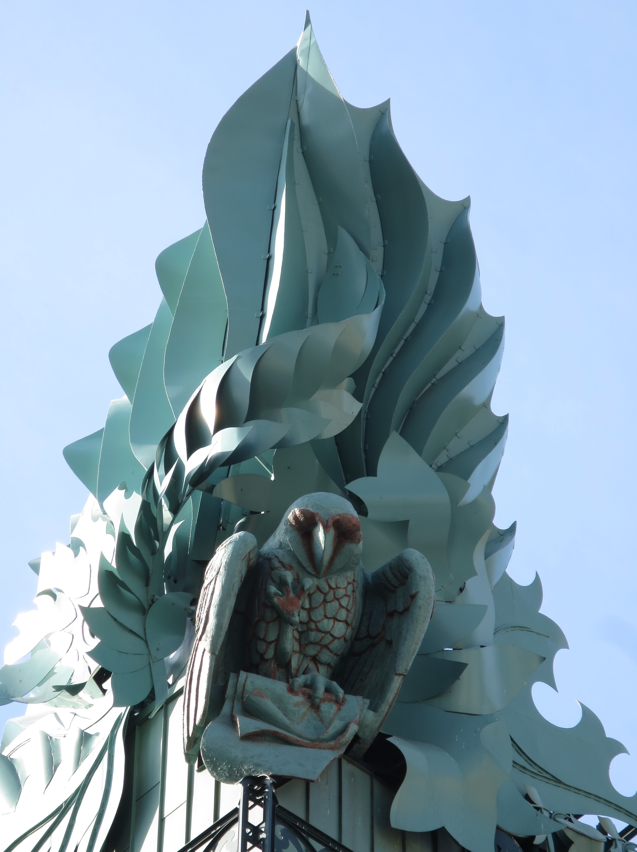
Notes:
The owls were designed by Raymond Kaskey and cast in aluminum. The sculpture is pale green, resembling weathered copper. It symbolizes knowledge and wisdom, fitting for a library.

Slide 3
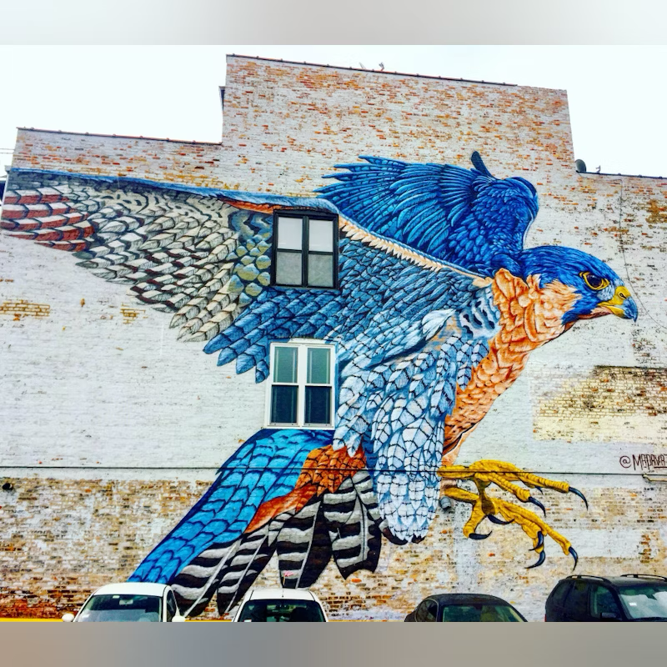
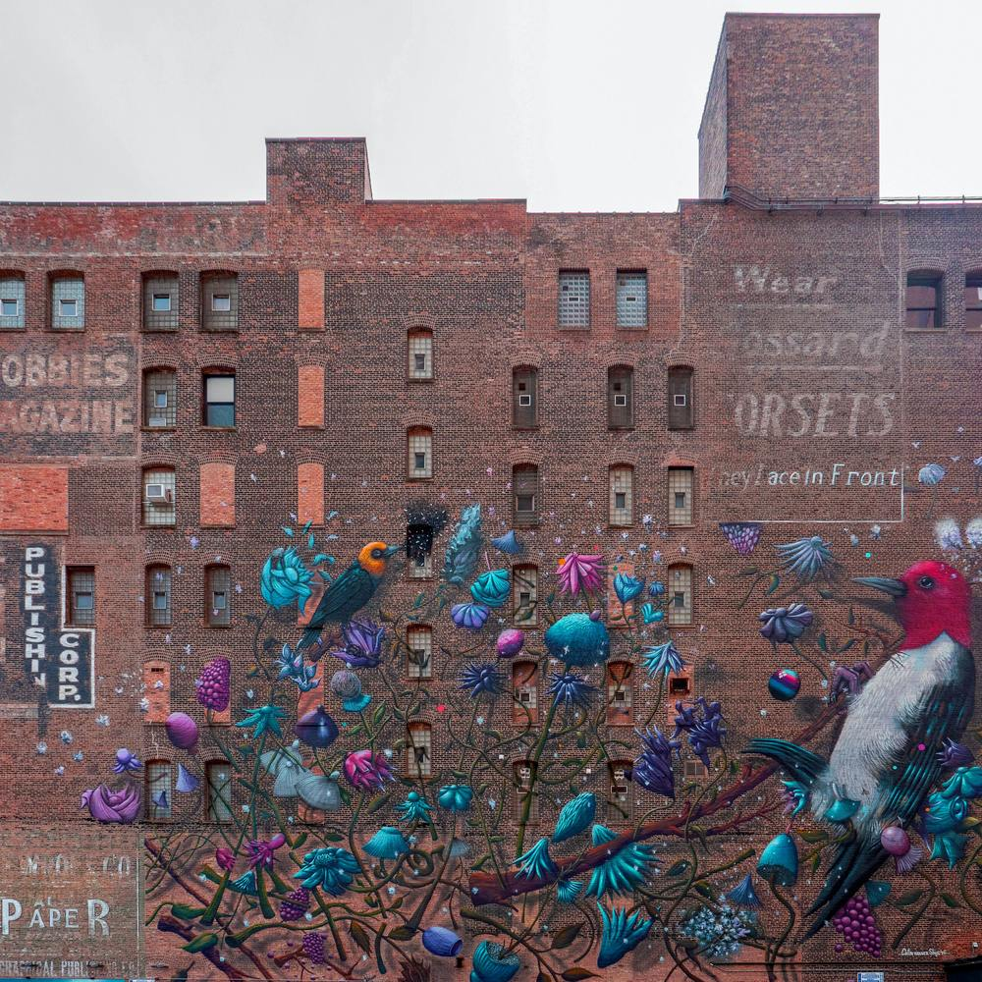
Notes:
Justin Suarez, Peregrine Falcon, 1708 W. Chicago Ave
Collin Van Der Sluijs, 1006 South Michigan Ave

Slide 4
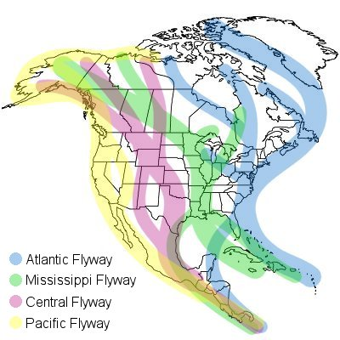
Notes:
Carbon reduction and adaptive reuse in general - is often treated merely as a technical necessity rather than an impetus for design creativity. We needed new metaphors and new taxonomies to expand our creativity.
Maybe grafting could provide a useful model…… We needed more precise language, new metaphors and new taxonomies to expand our creativity.

Slide 5
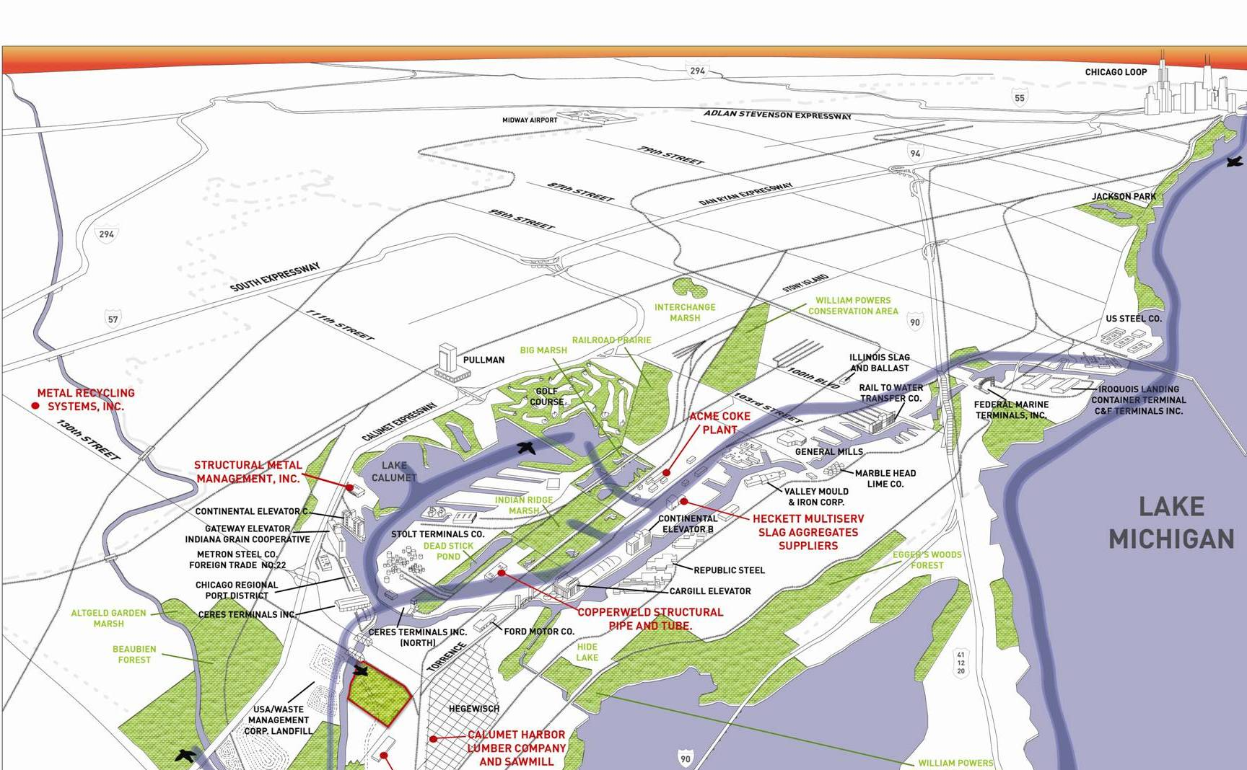
The eco-industrial landscape

Slide 6
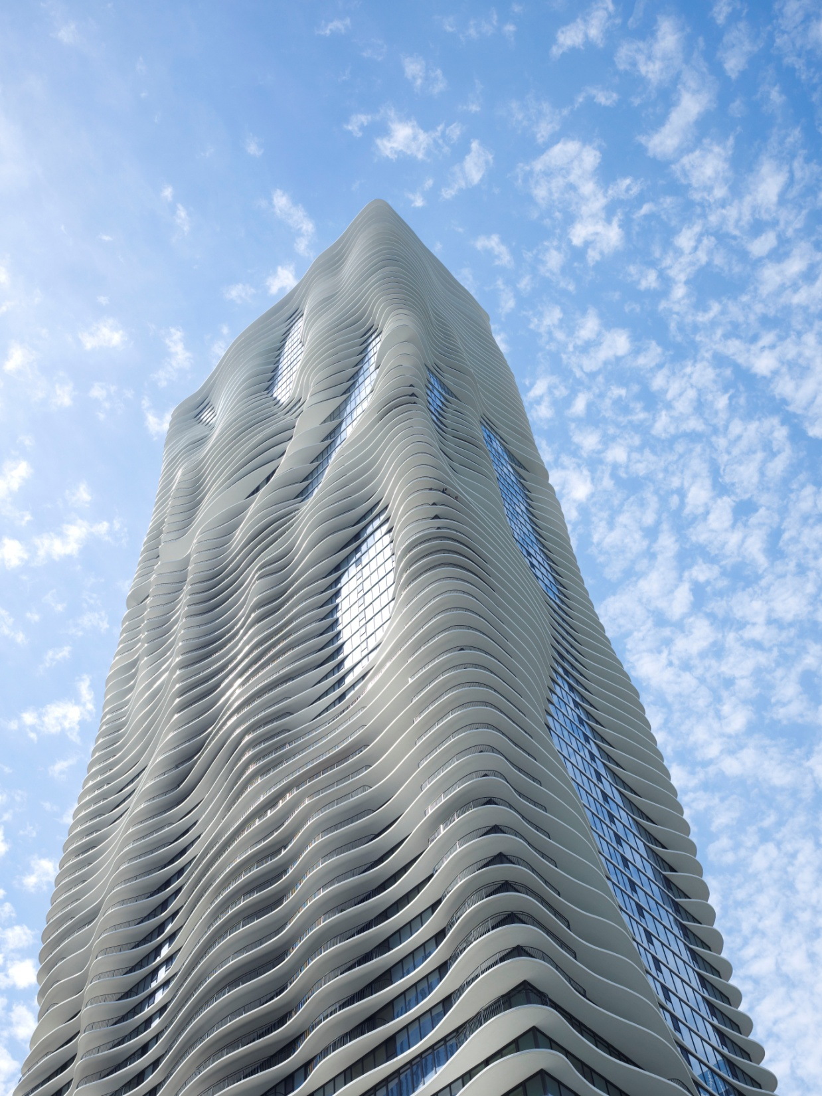
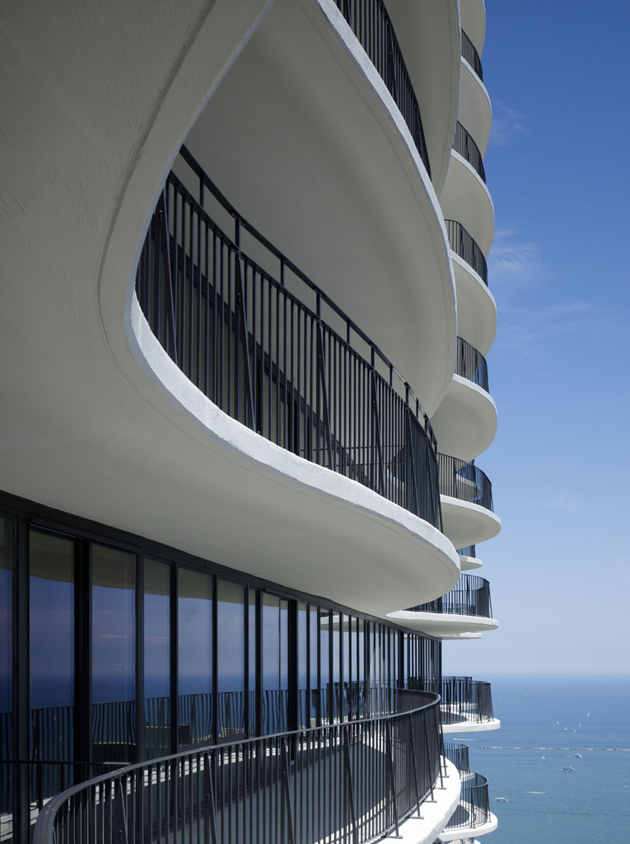

Slide 7
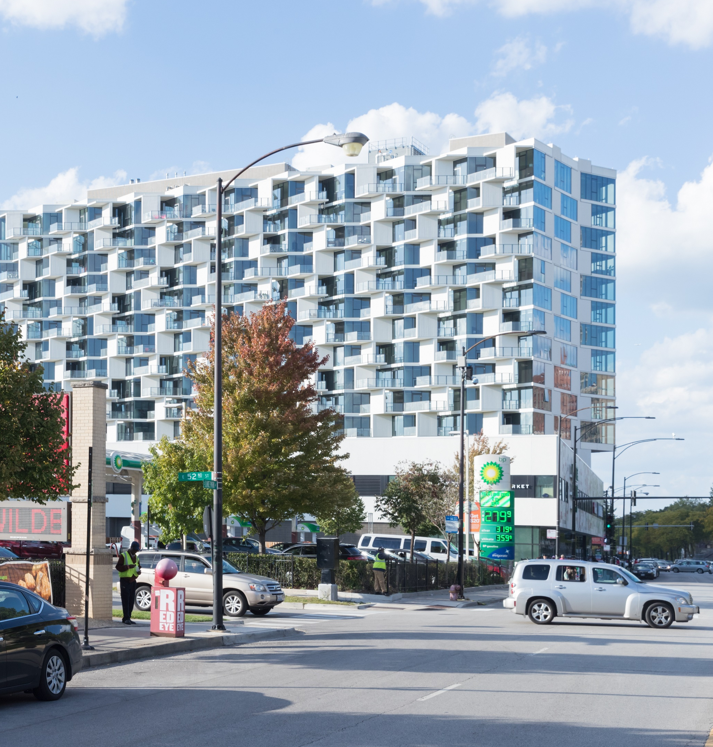
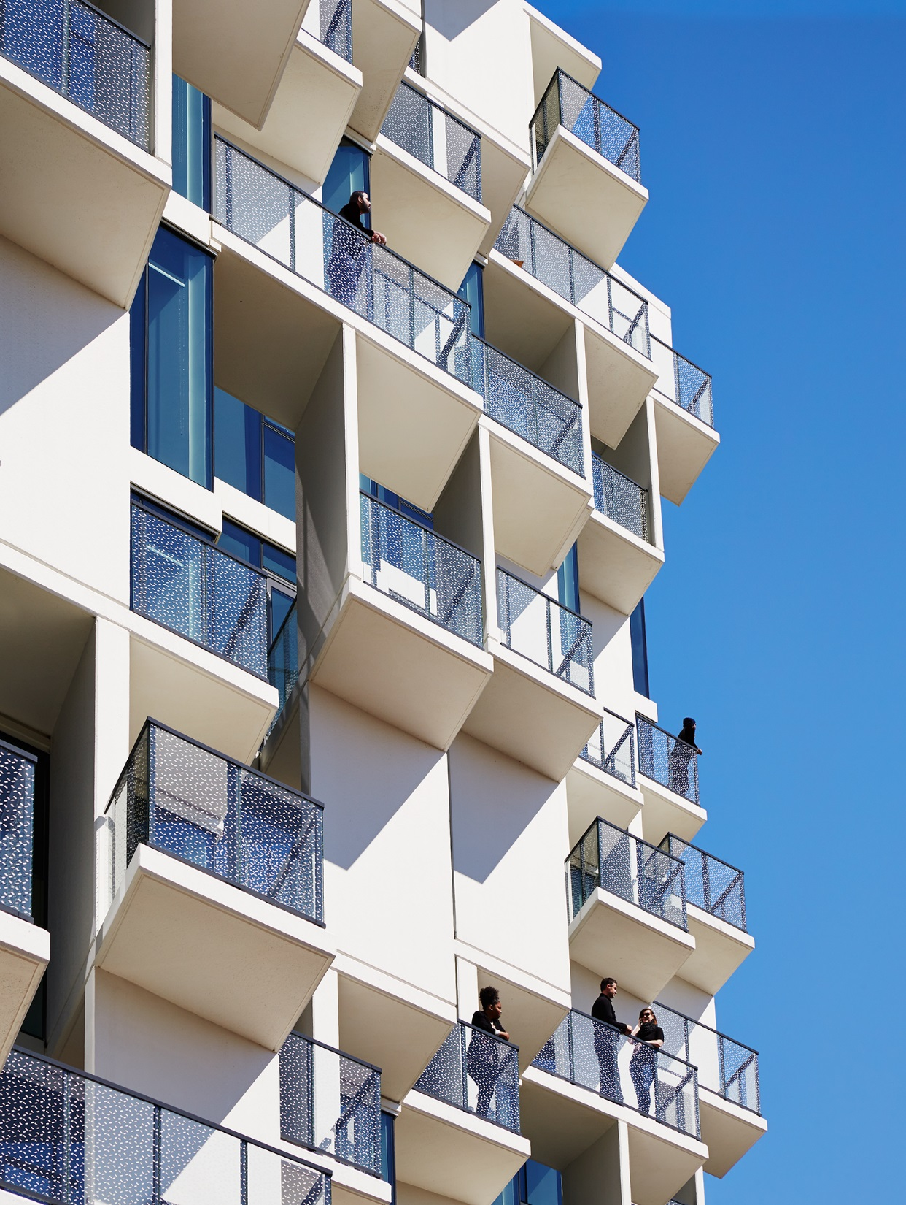

Slide 8
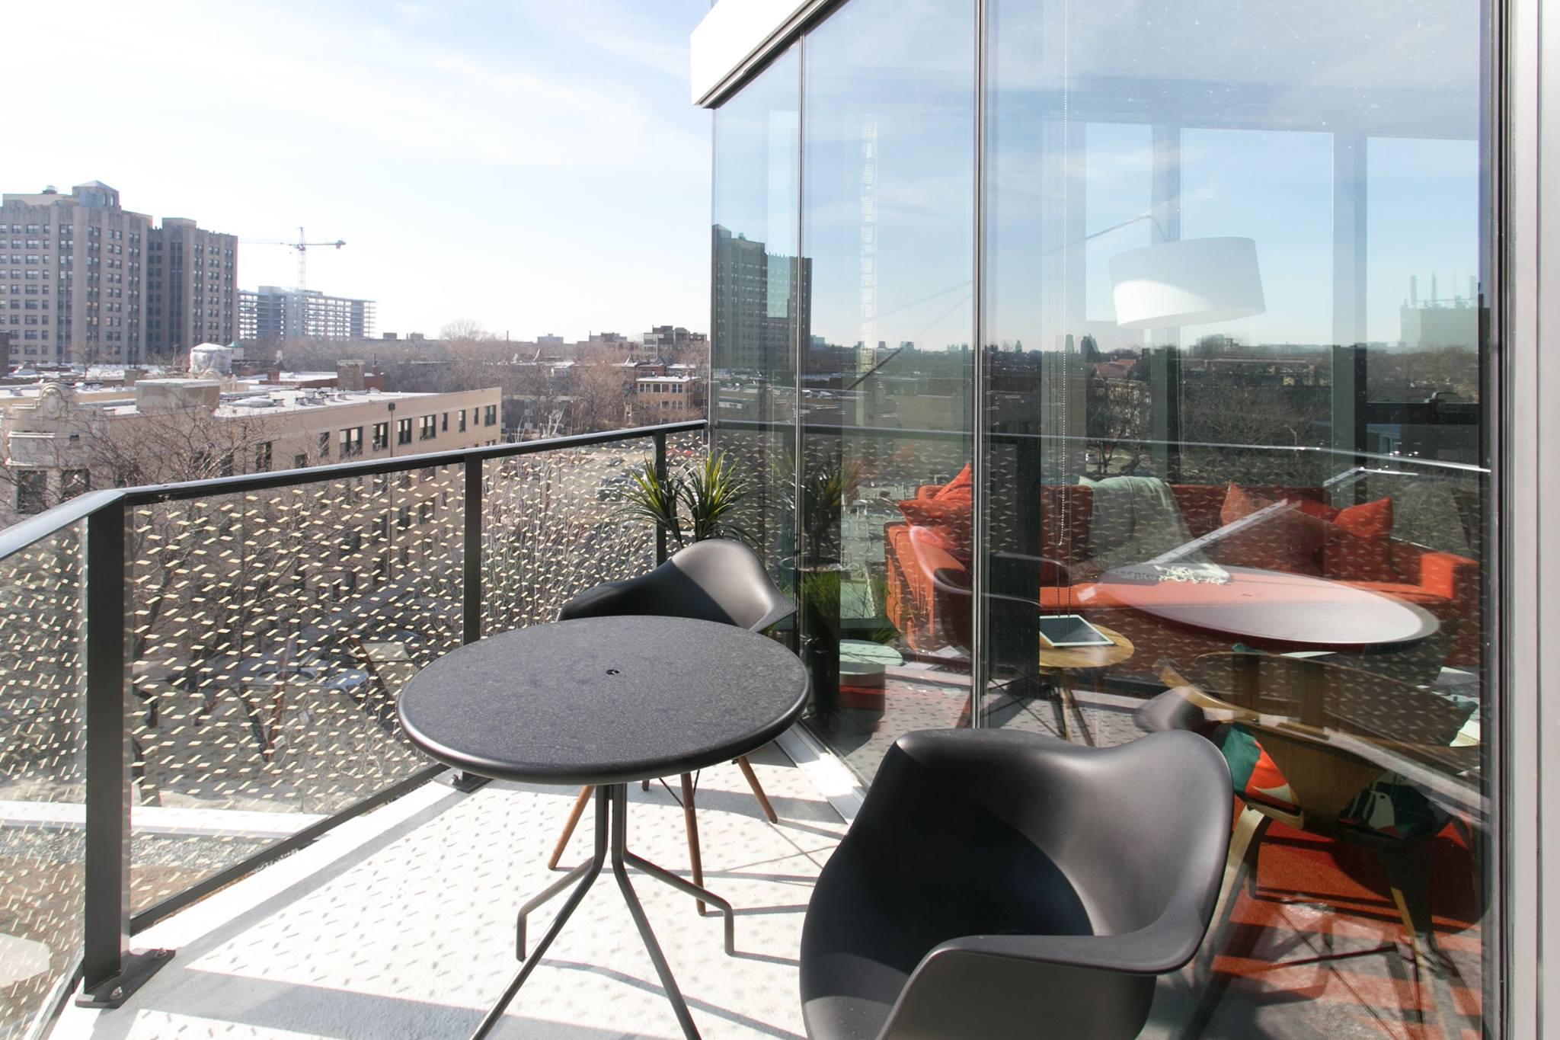

Slide 9
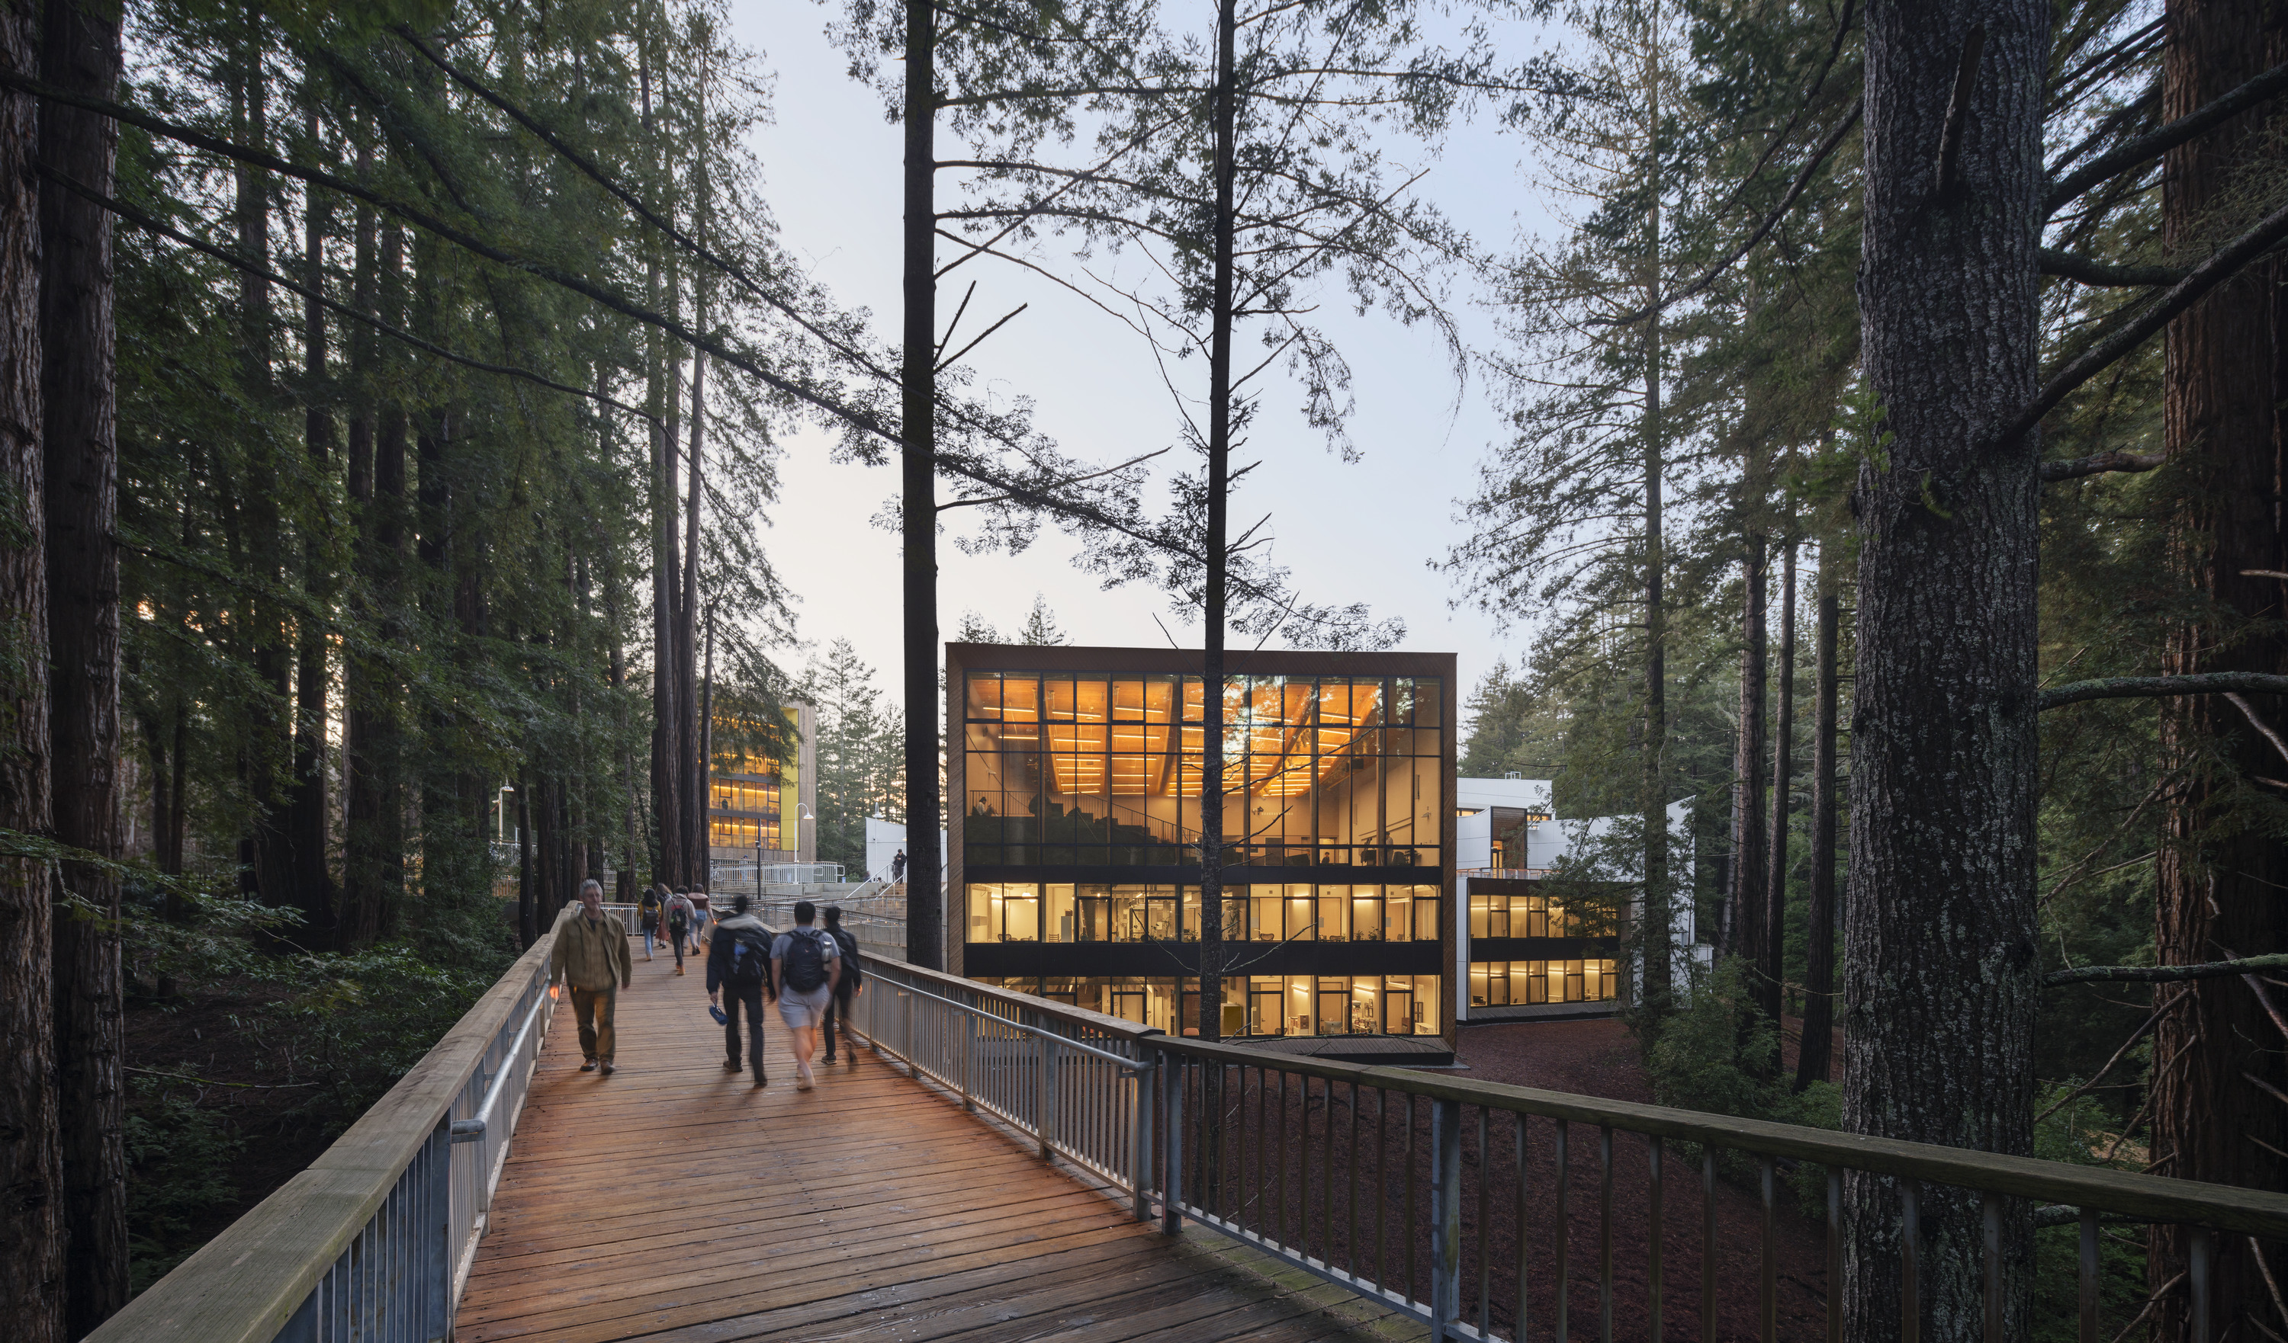
Kresge College at
University of California Santa Cruz
Notes:
It is a much bigger project set within a redwood forest - that adds on to an existing college
So the structure and the finishes are the same and we can significantly reduce the carbon.

Slide 10
