Slide 1

Stormwater Management and
Tunnel and Reservoir Plan
Chicago Committee on Environmental Protection and Energy
Saturday September 1, 2026

Slide 2

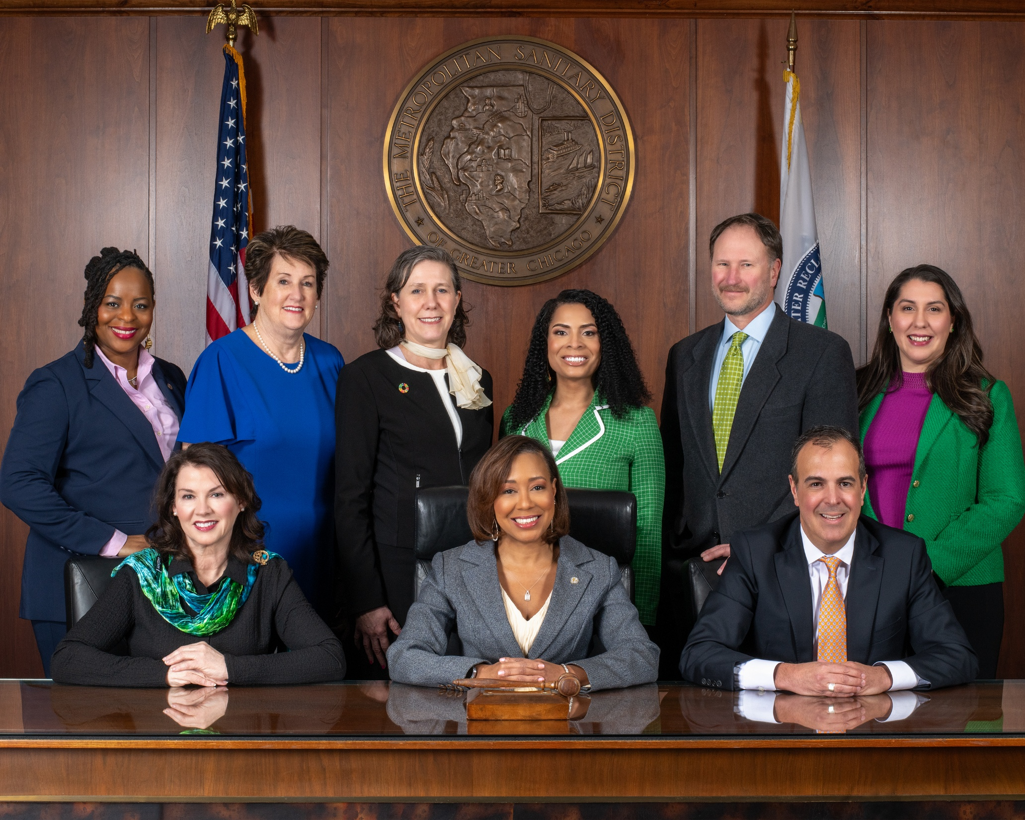
Notes:
Acknowledge the Board

Slide 3
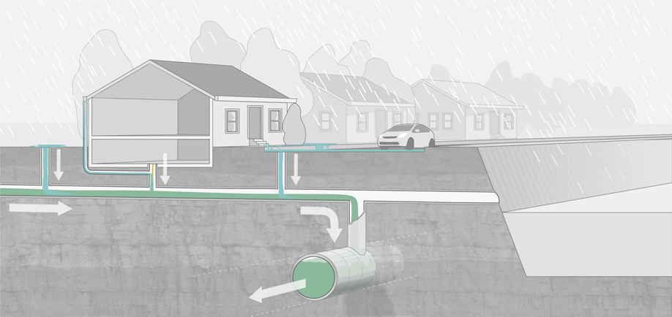
Combined Sewer System
Local Sewer
Chicago Sewer System
Waterway
MWRD Intercepting Sewer
Flows to MWRD Water Reclamation Plants
Notes:
As DWM mentioned, Chicago has a very old combined sewer system. During dry weather, the City’s sewers discharge into MWRD interceptors that convey the sewage to one of our treatment plants.

Slide 4
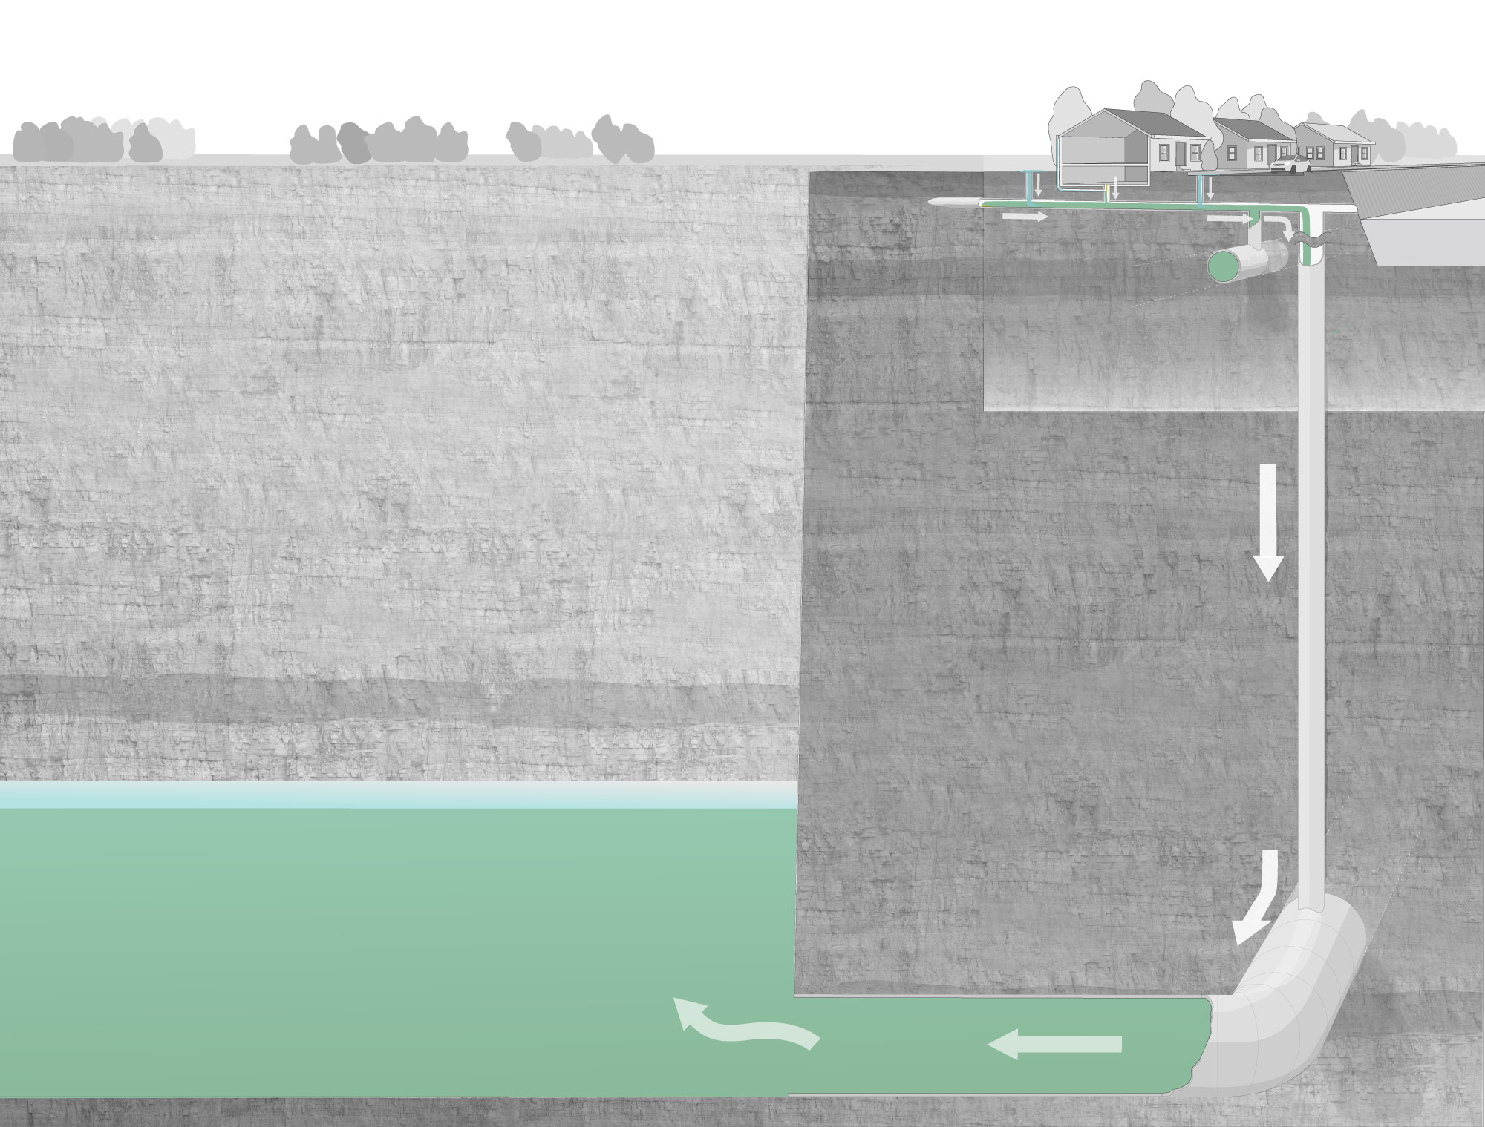
1. Home
Three Connected Systems
2. Local Municipal Sewers
3. MWRD Intercepting Sewers and TARP
Notes:
In wet weather, the combined sewers fill to capacity and overflow is sent to our deep tunnels and reservoirs to be stored until after the storm when it can be pumped to a treatment plant to be cleaned and then discharged to the waterways.

Slide 5
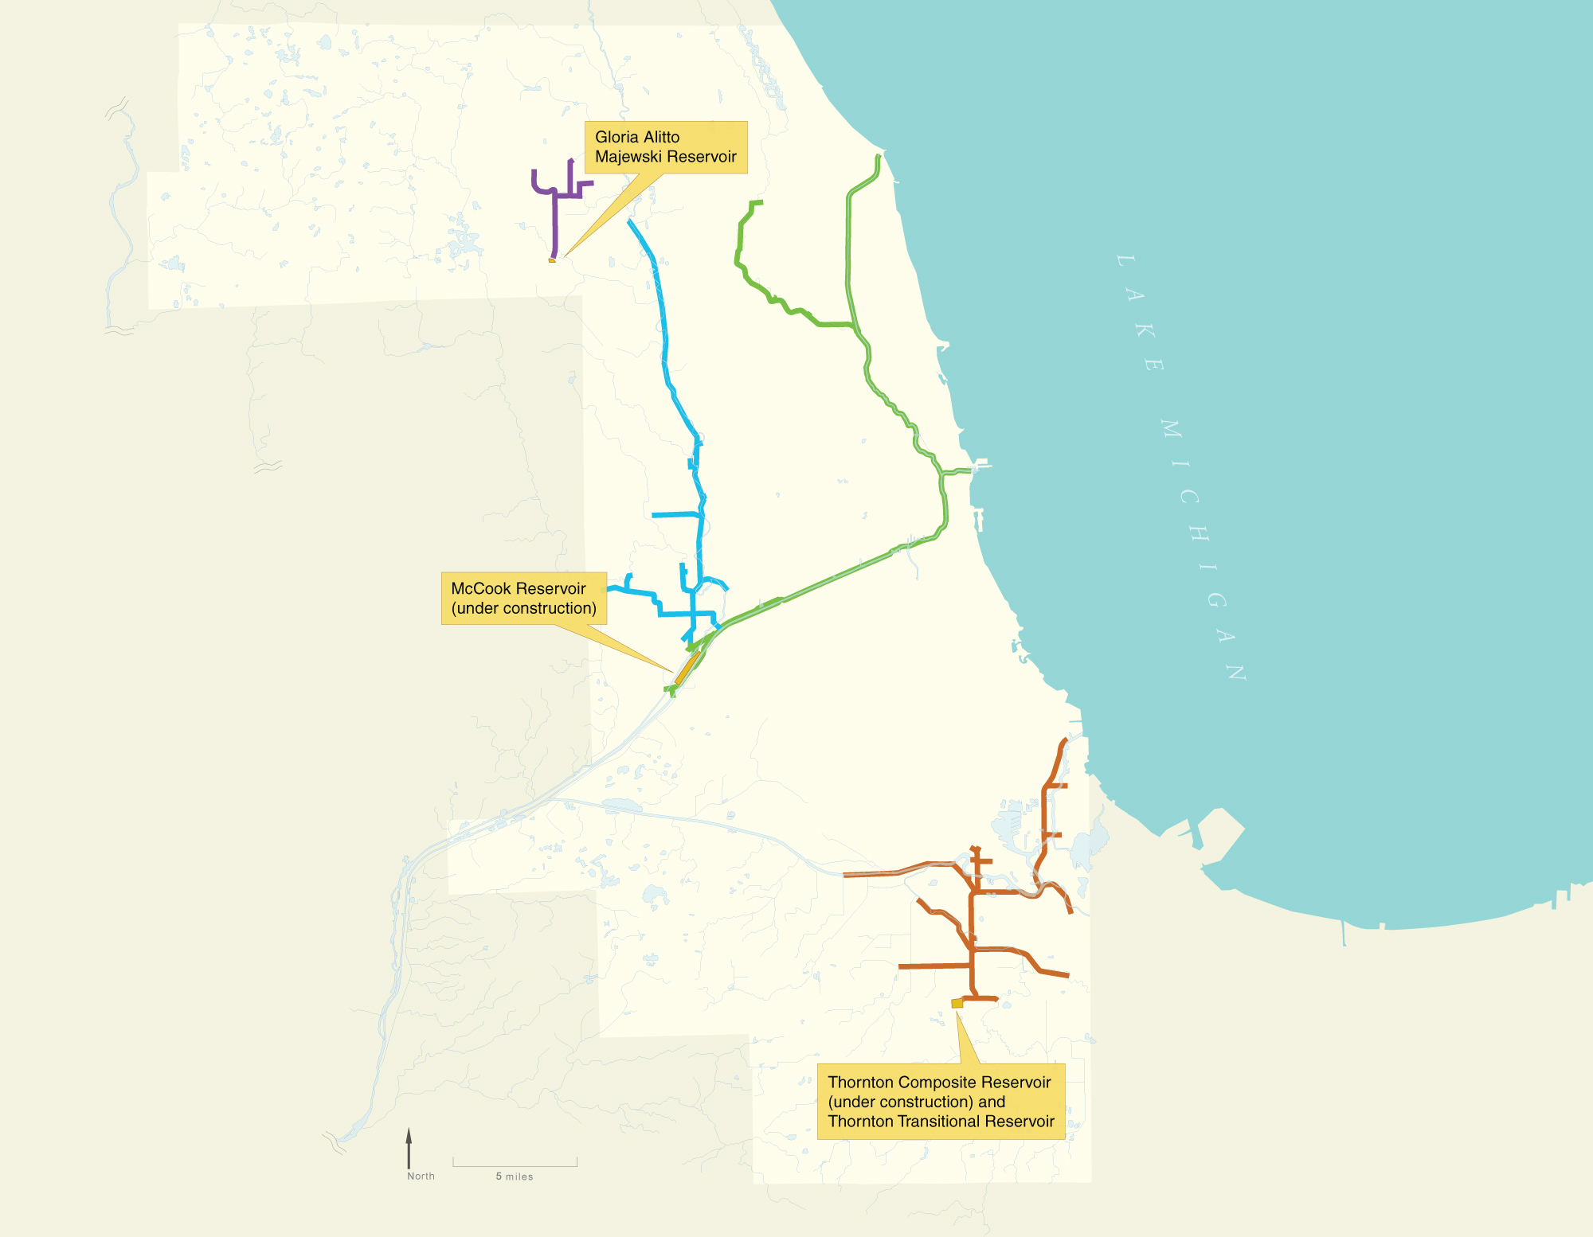

Tunnel and Reservoir Plan (TARP)
Phase I Tunnels:
Upper Des Plaines
6.6 miles
Storage: 70 MG
Des Plaines
25.6 miles
Storage: 405 MG
Mainstream
40.5 miles
Storage: 1,200 MG
Calumet
36.7 miles
Storage: 630 MG
Phase II Reservoirs:
Majewski
Storage: 350 MG
McCook Phase 1
Storage: 3.5 BG
Thornton Composite Reservoir
Storage: 7.9 BG
Thornton Composite Reservoir
Notes:
There are a total of 110 miles of deep tunnels that are up to 33’ in diameter and 300 feet below ground. They convey the captured combined sewage and stormwater to three reservoirs. Both the McCook and Thornton Reservoirs serve the city of Chicago. Currently, the McCook Reservoir has a capacity to hold 3.5 BG of water but it is undergoing an expansion and when completed in 2032 it will be able to hold 10 BG.

Slide 6
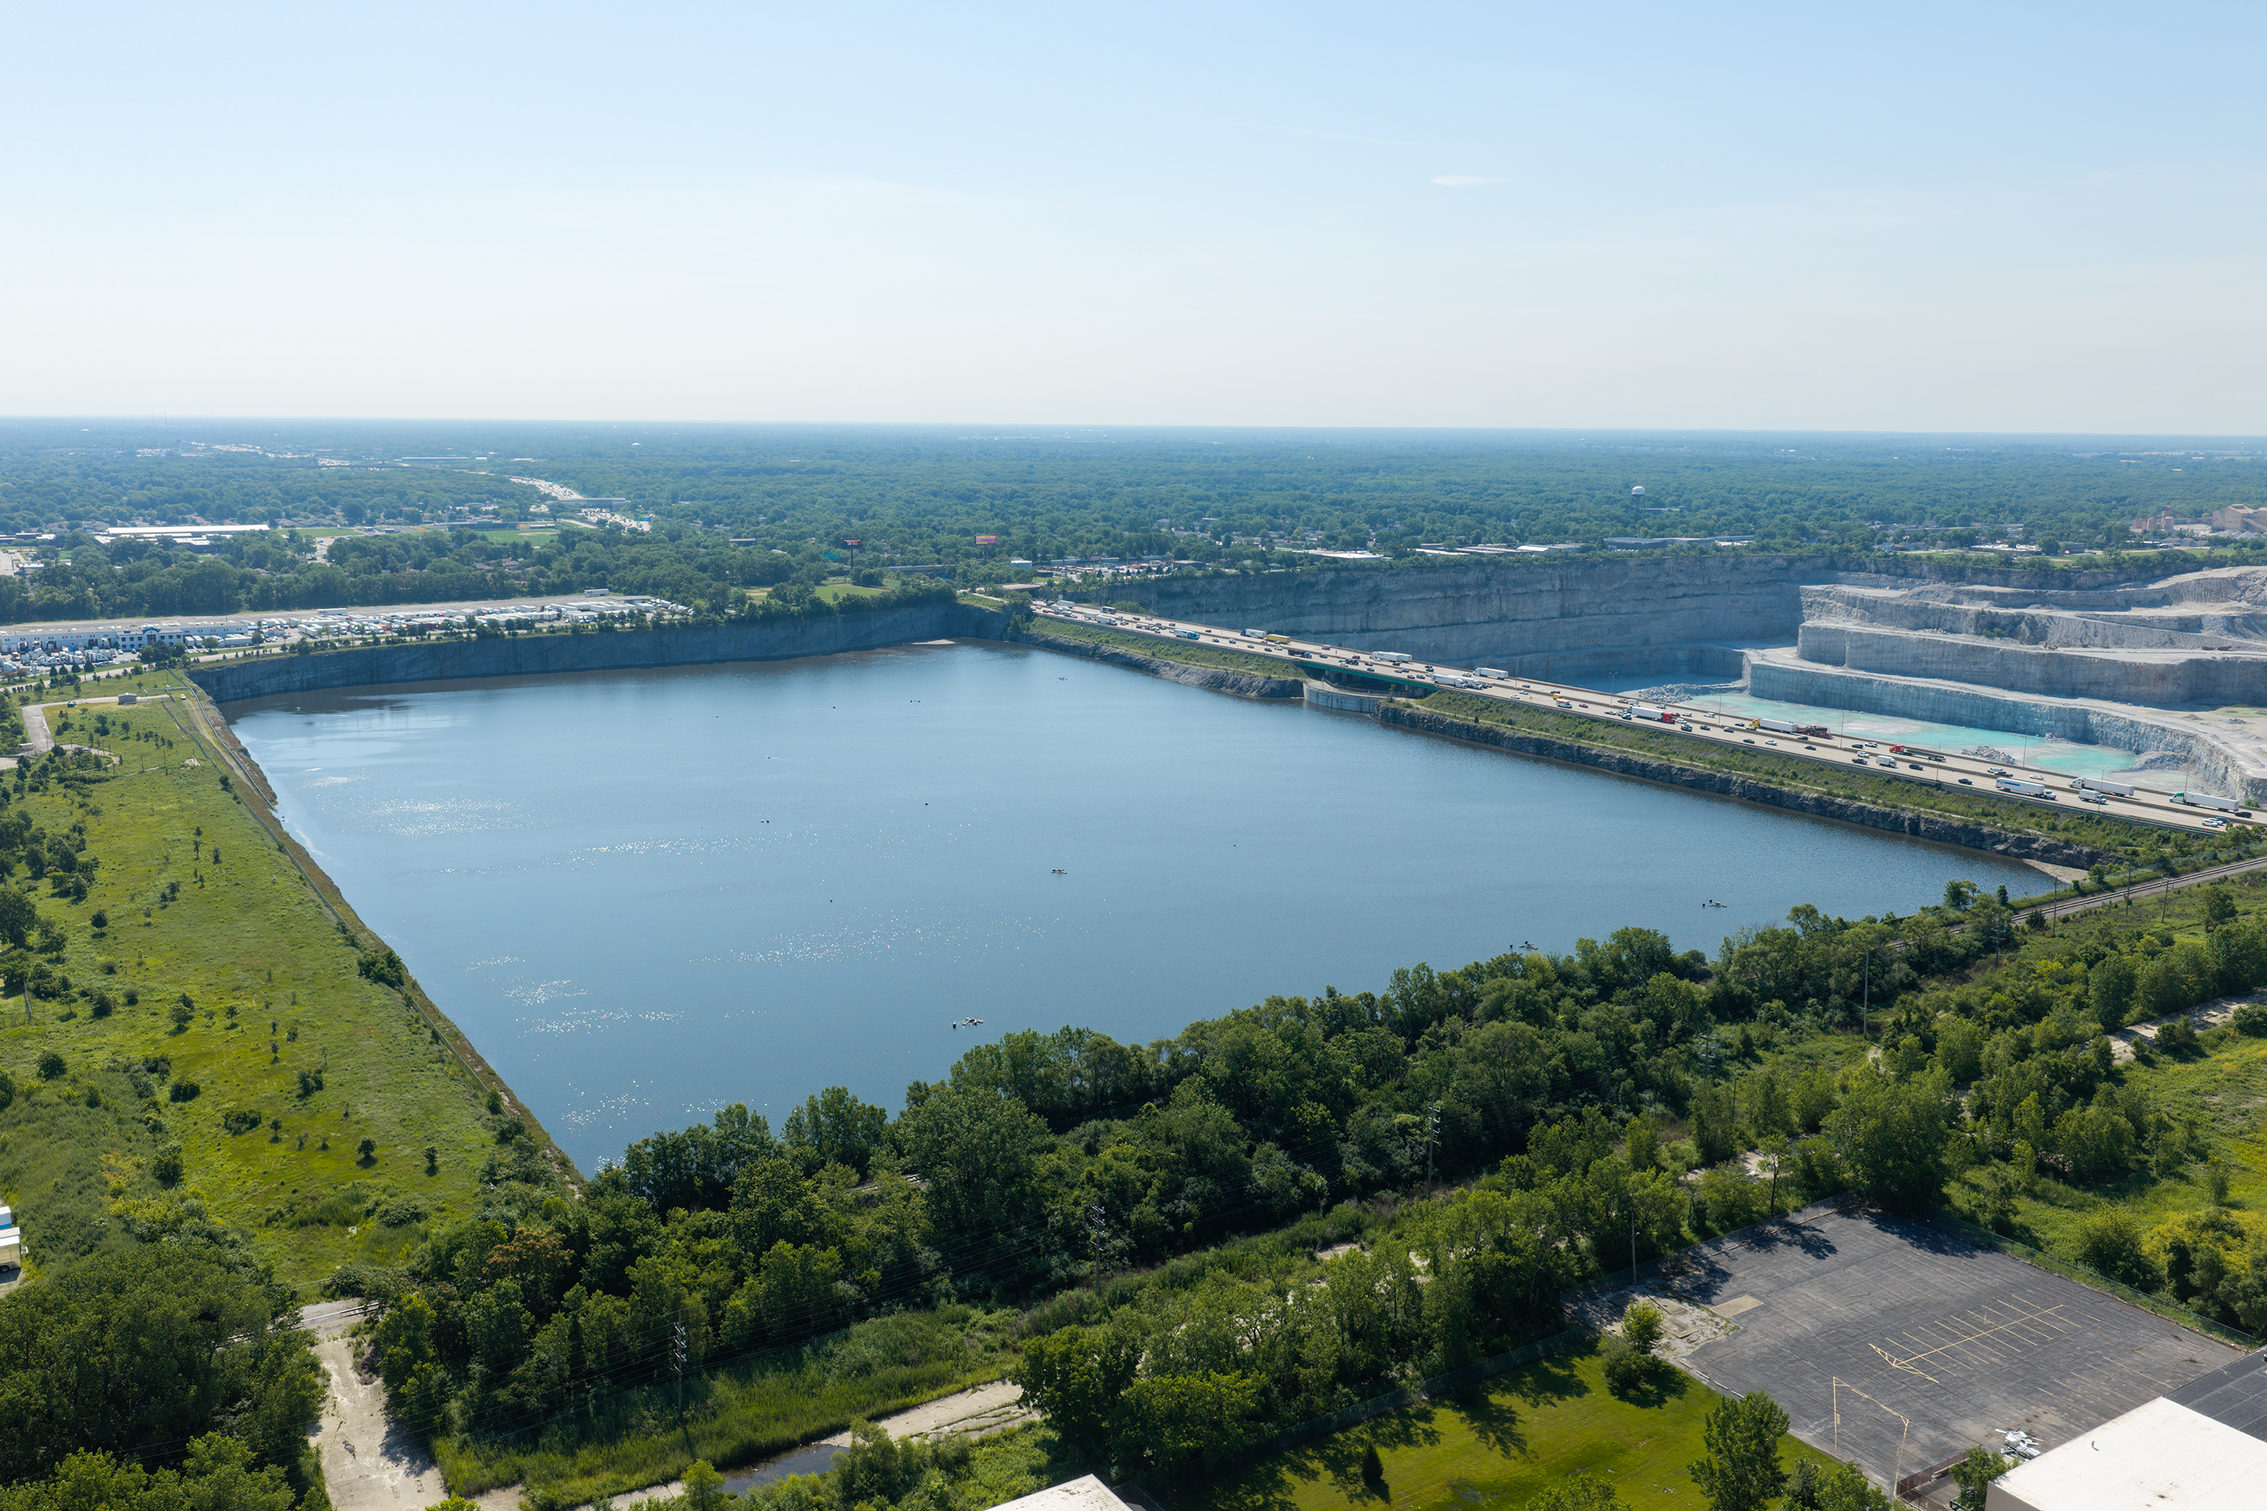
Thornton Composite TARP Reservoir
7.9 Billion Gallons Completed in 2015
Notes:
The McCook Reservoir has filled to capacity 7 times already this year, which is more times than the previous 5 years combined. Also, Thornton which is shown here approached it’s capacity for the first time ever since coming online over ten years ago.

Slide 7
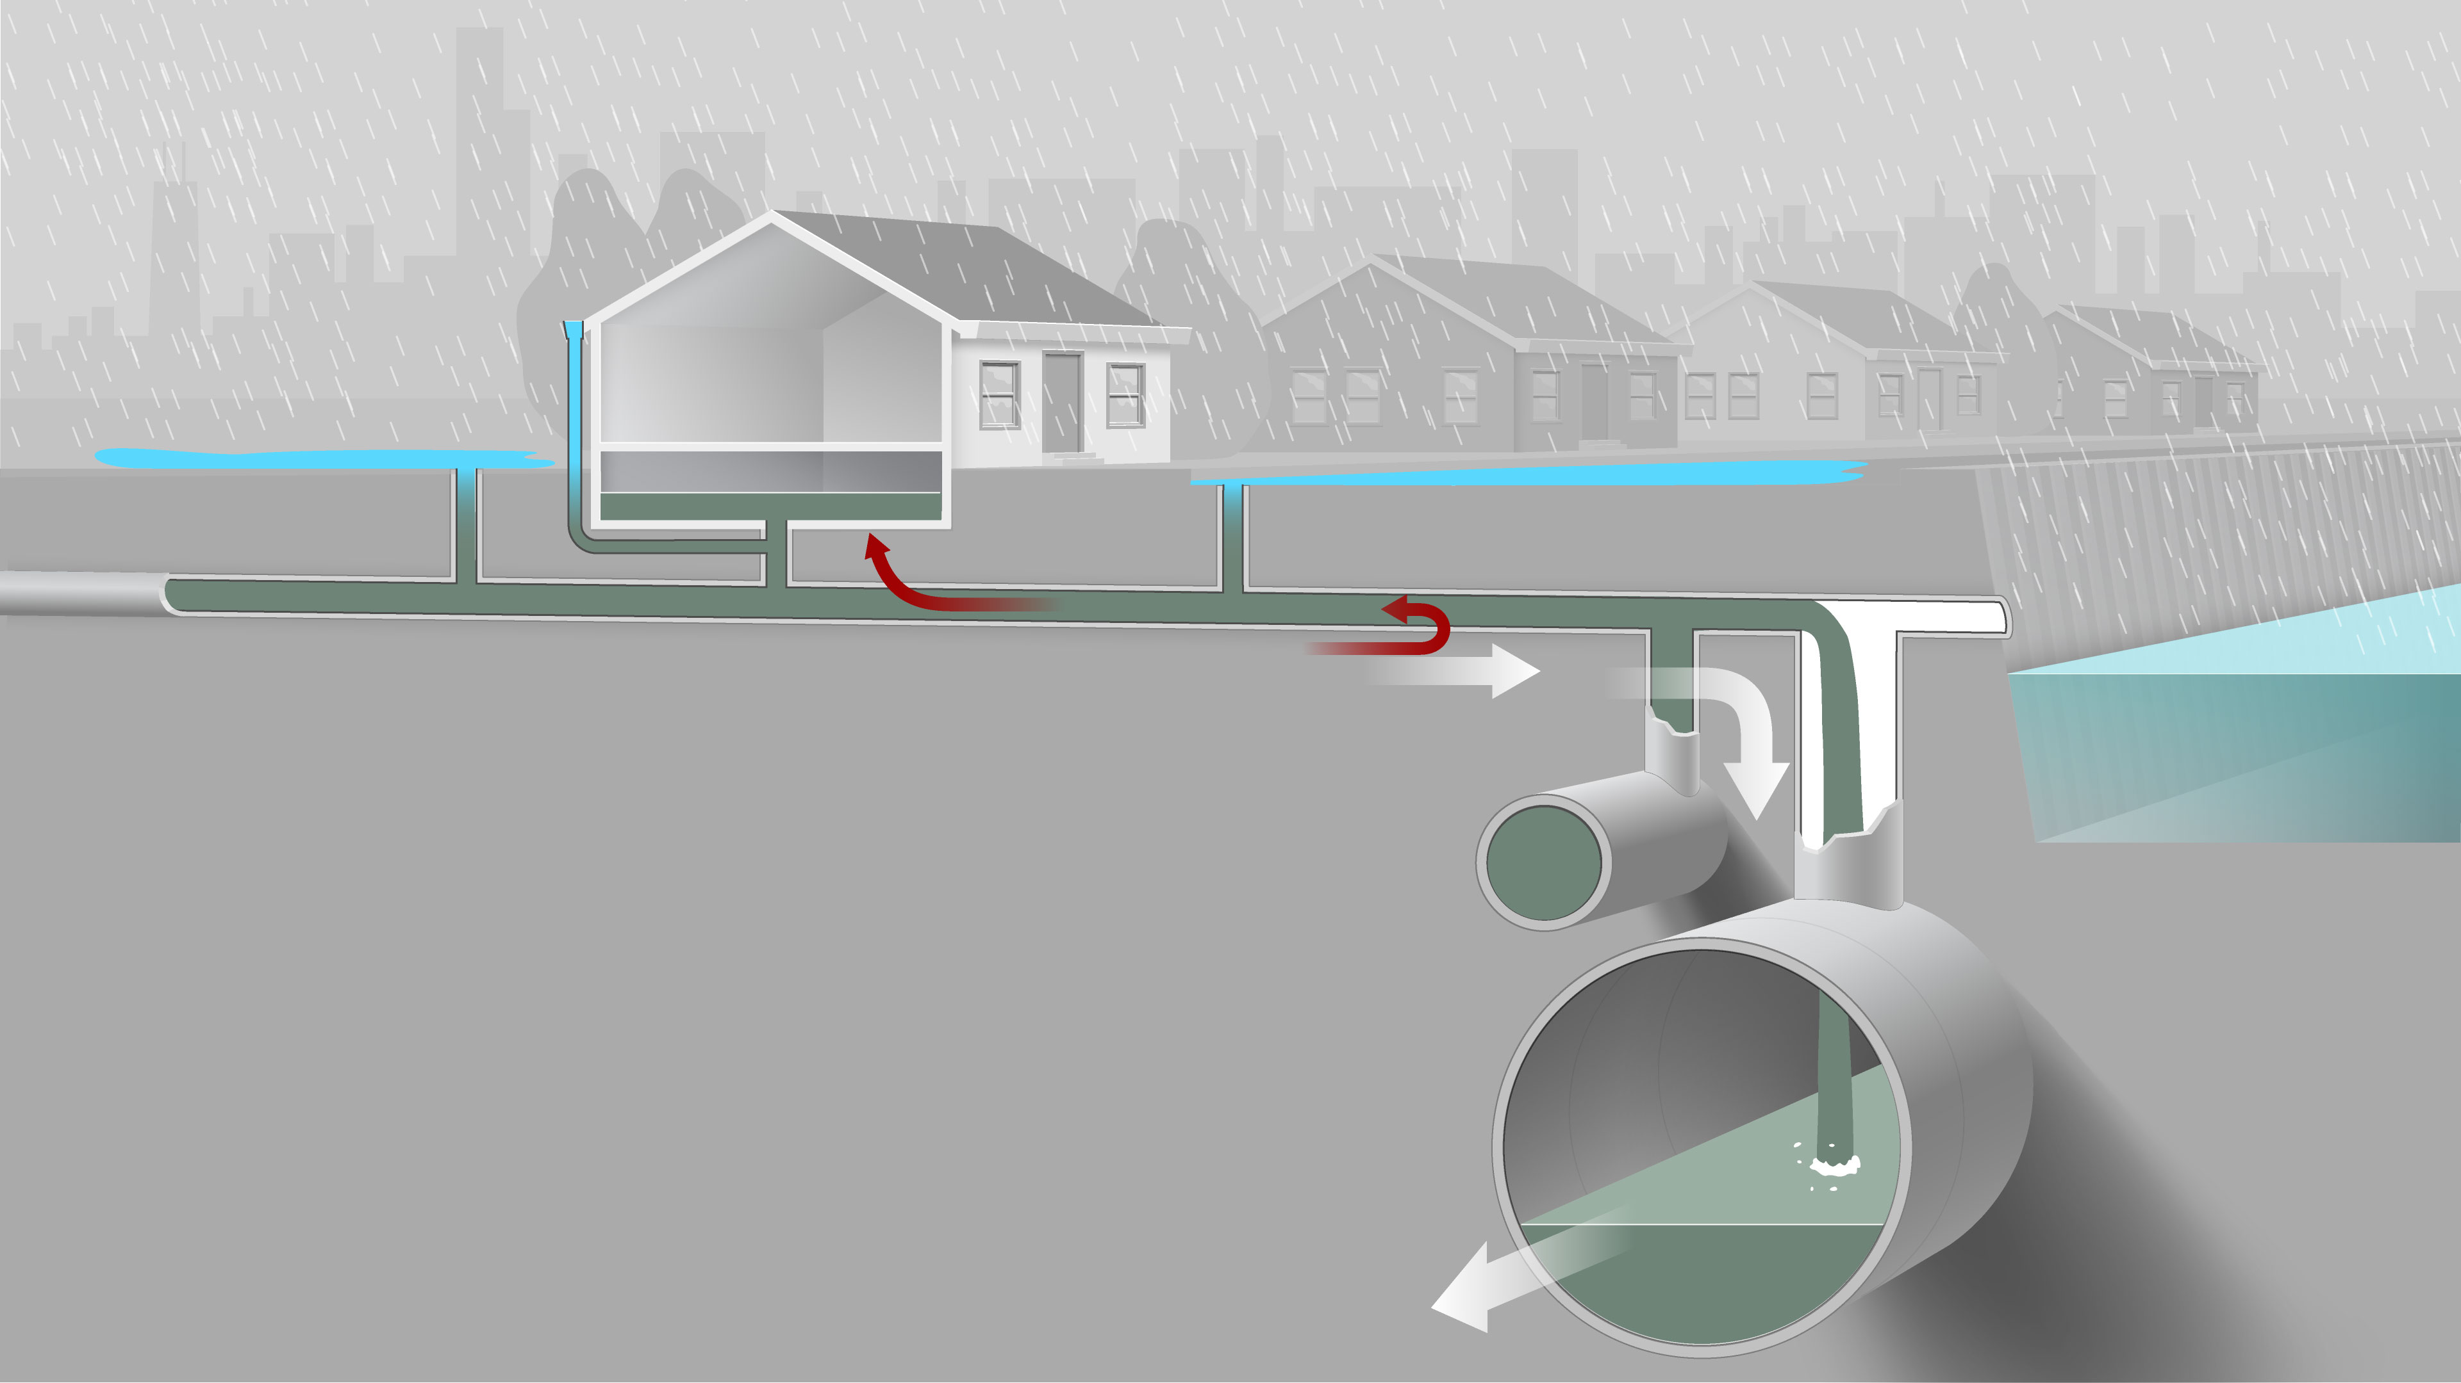
Basement backups and street flooding
Notes:
However, even TARP has capacity in the reservoirs, flooding can still occur. When a lot of rain falls in a concentrated area over a short period of time, as what happened in July 2023, stormwater may enter sewers faster than it can ﬂow through them, exceeding their flow capacity. When this happens, some of the combined sewage cannot reach TARP or the waterway quickly enough and it can back up into low-lying streets and unprotected basements.
Another way to describe it is that you have all of this rainfall heading to the sewer and not enough sewer capacity to carry it away. It’s almost like the water needs to wait in line to get through the sewer system, and while it is waiting, it’s filling the system up starting at the lower points.
Combined sewer systems are generally designed at around the 5 year storm, and it’s prohibitively expensive to build sewer systems to handle a 50 or 100 year events, but these intense storms are occurring more frequently

Slide 8
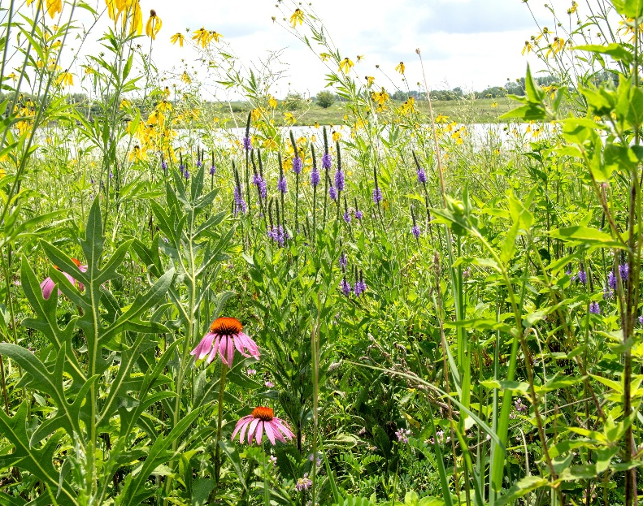
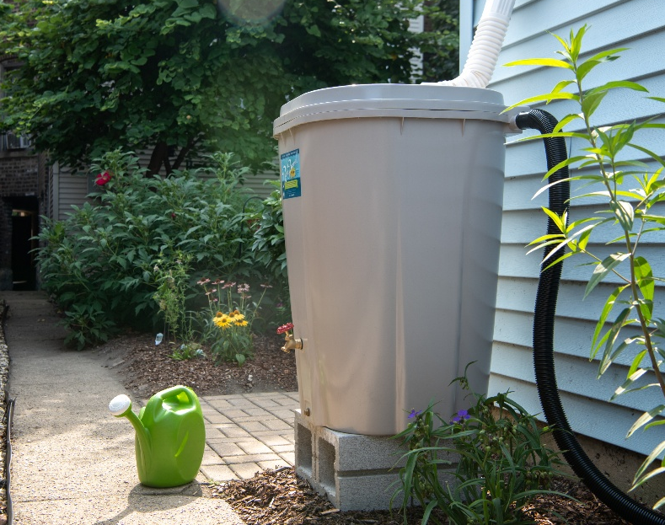
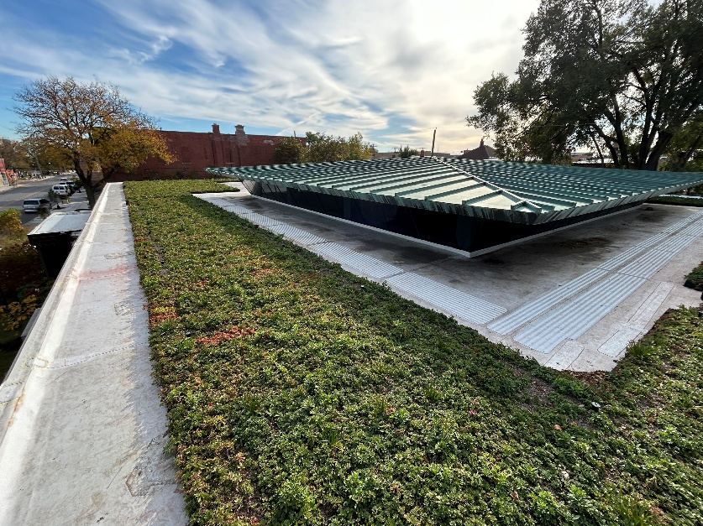
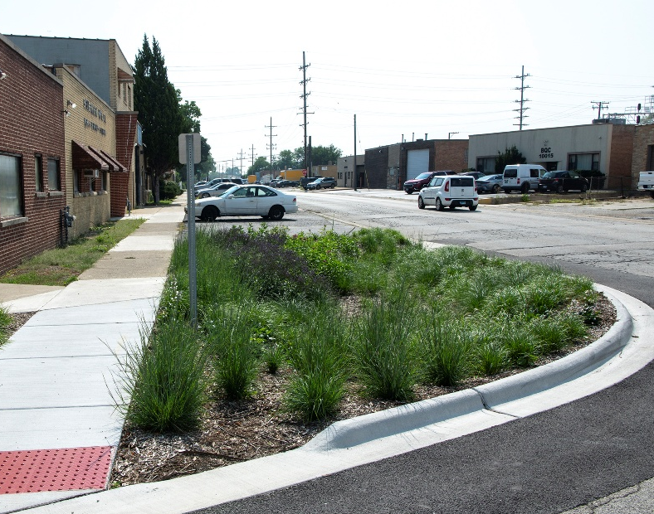
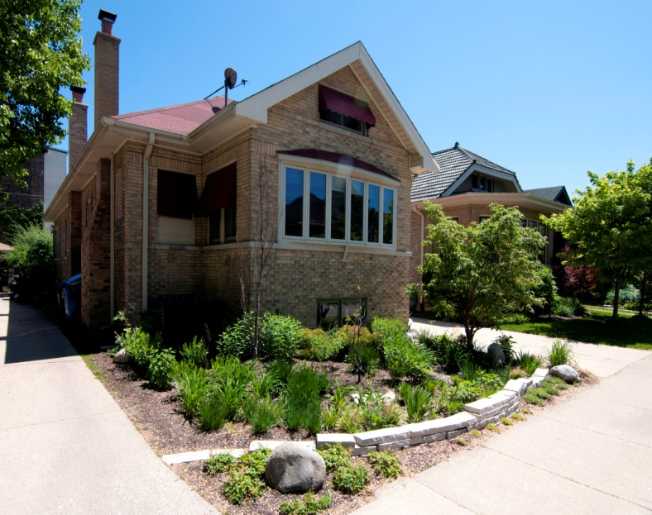
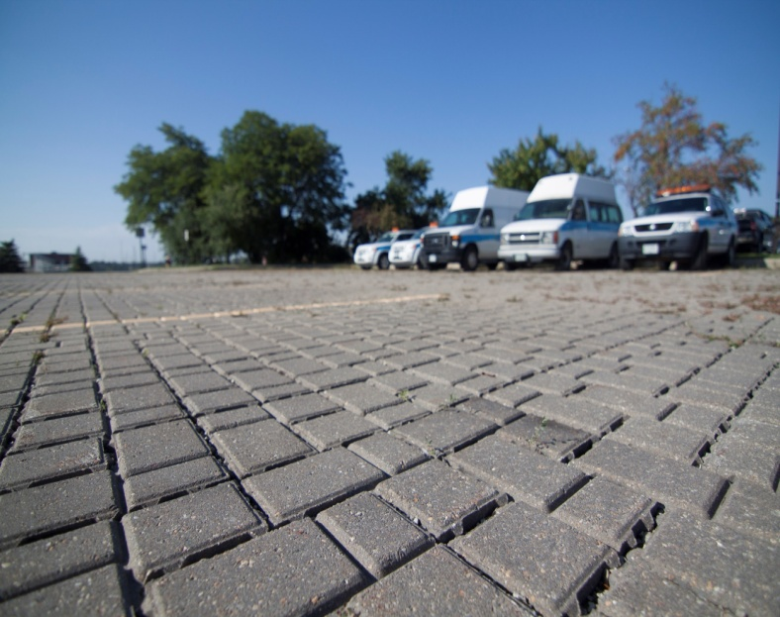
Green Infrastructure
Native Prairie Landscaping
Rain Barrel
Native Landscaping
Rain Barrel
Green Roof
Rain Garden
Bioswale
jardines de lluvia
Permeable Pavement
Notes:
This is why MWRD is partnering with Chicago agencies and suburban communities to build a more resilient system that not only includes large regional projects, but also local stormwater management projects including green and gray infrastructure, which will slow down or reduce the flow of water to the sewer system.

Slide 9
MWRD Stormwater Management Partnership with Chicago
Albany Park Stormwater Diversion Tunnel
Completed in 2018 through an IGA Partnership between MWRD and CDOT this 18’ diameter, 1.4 mile long tunnel diverts floodwaters from the North Branch of the Chicago River downstream to the North Shore Channel to protect the Albany Park neighborhood from flooding.
Space to Grow
IGA Partnership between MWRD, CDWM, and CPS as transformed 41 schoolyards into vibrant learning spaces that can also retain 8.8 MG of water every time it rains
Wing Storage Project
MWRD and CDWM partnered on two underground detention vaults that provide nearly 1.7 MG of storage, with discussions of future similar projects ongoing

Slide 10
MWRD Stormwater Management Partnership with Chicago
Chicago Park District
MWRD and the Chicago Park District have partnered on native landscaping projects and are in discussions for a master agreement to complete green and gray stormwater projects at Chicago Park District locations.
Green Alleys
MWRD, CDWM and CDOT have partnered on green alleys in Chicago and discussions of future projects are ongoing
Downspout Disconnection
MWRD and CDWM have discussed collaborating on both private side and public building downspout disconnection programs.

Slide 11
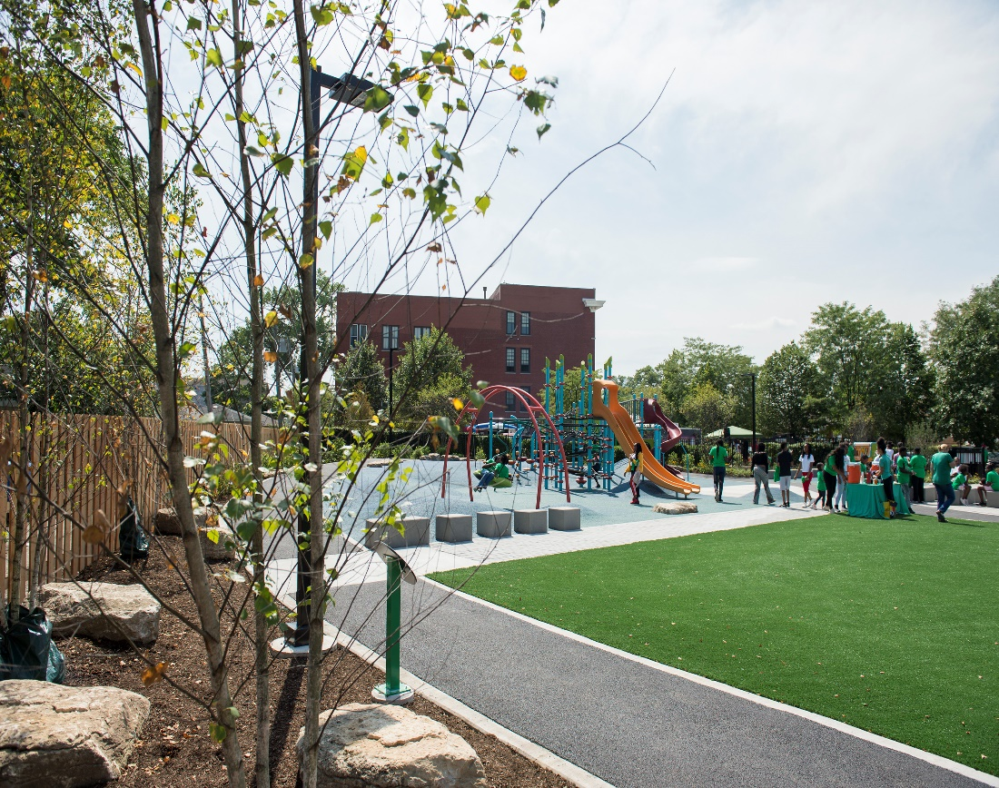
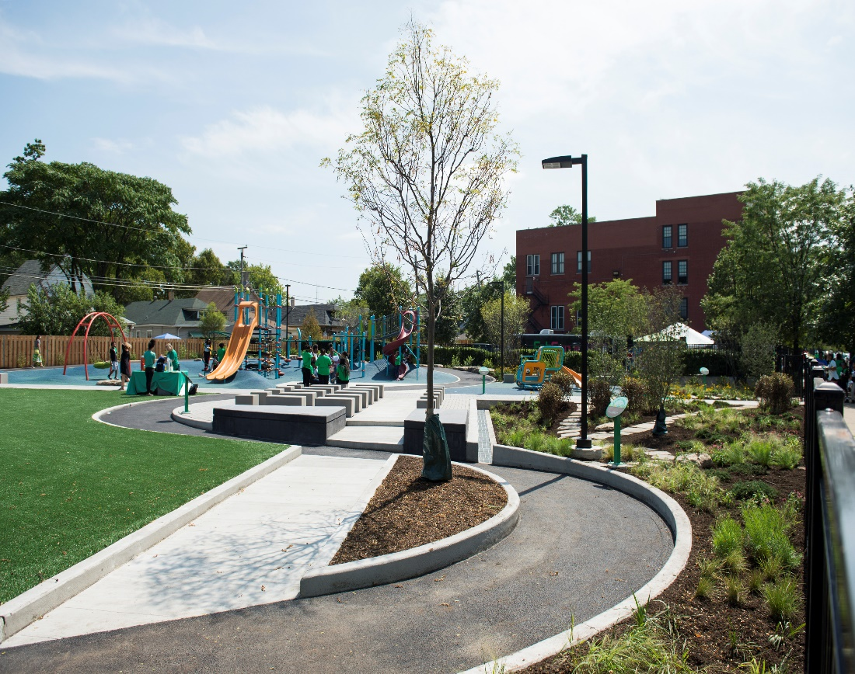
Green Infrastructure
Space to Grow: Greening Chicago Schoolyards
Fernwood Elementary - 2018

Slide 12
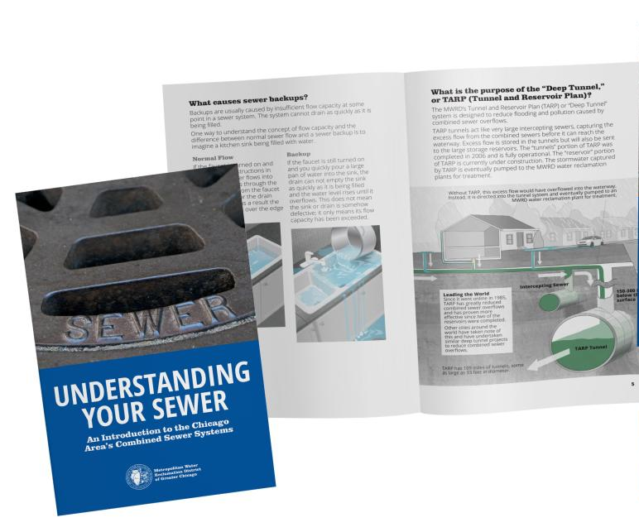
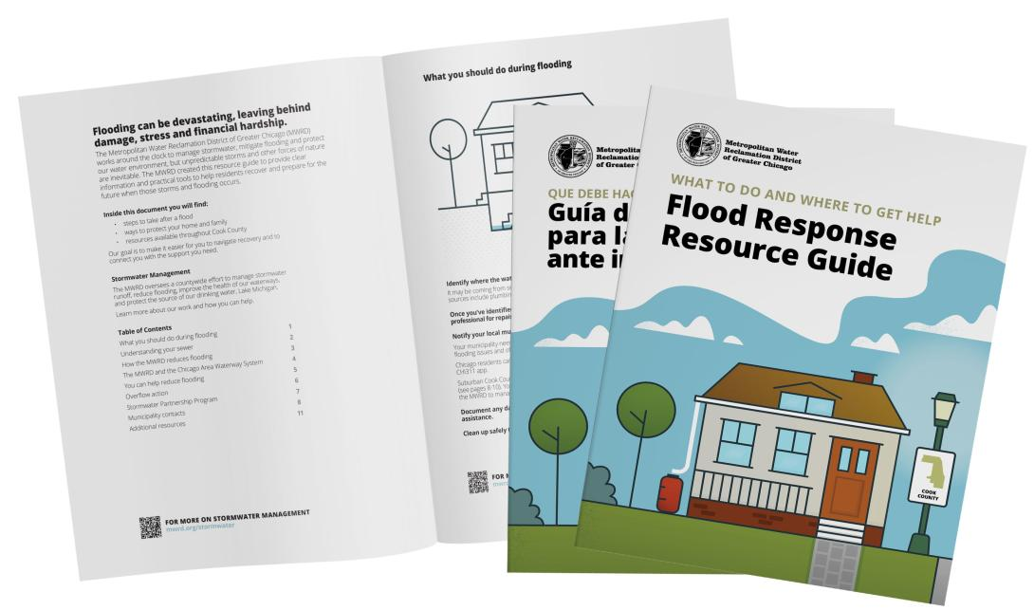

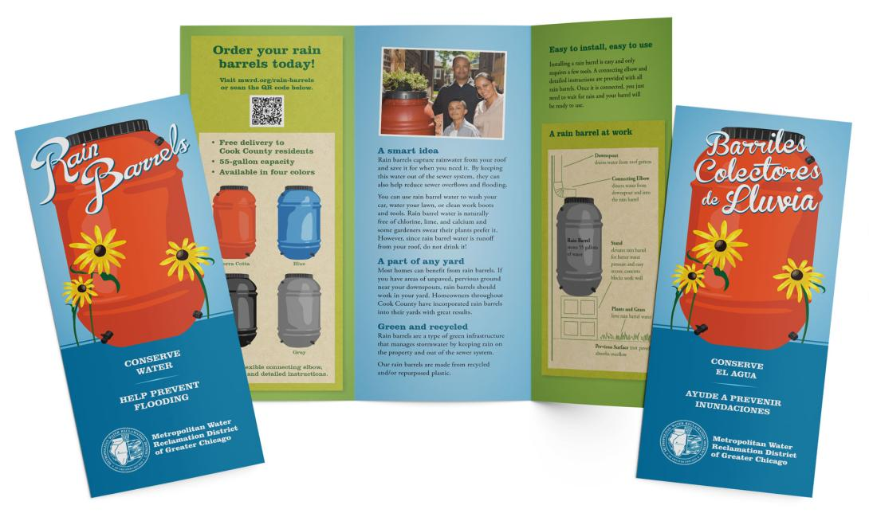
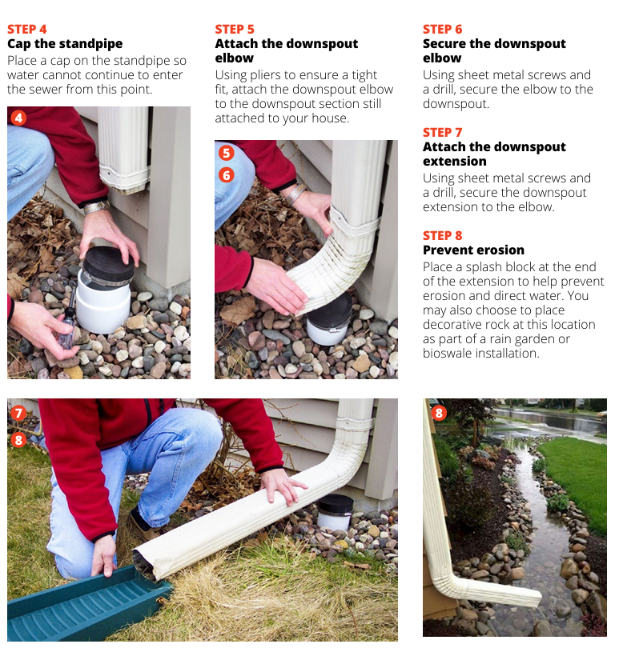
MWRD Resources available at mwrd.org/publications
Understanding Your Sewer
Flood Response Resource Guide
Green Neighbor Guide
Includes step-by-step instructions for homeowners to disconnect downspouts and other ways to manage runoff on private property
Rain Barrels

