Slide 1
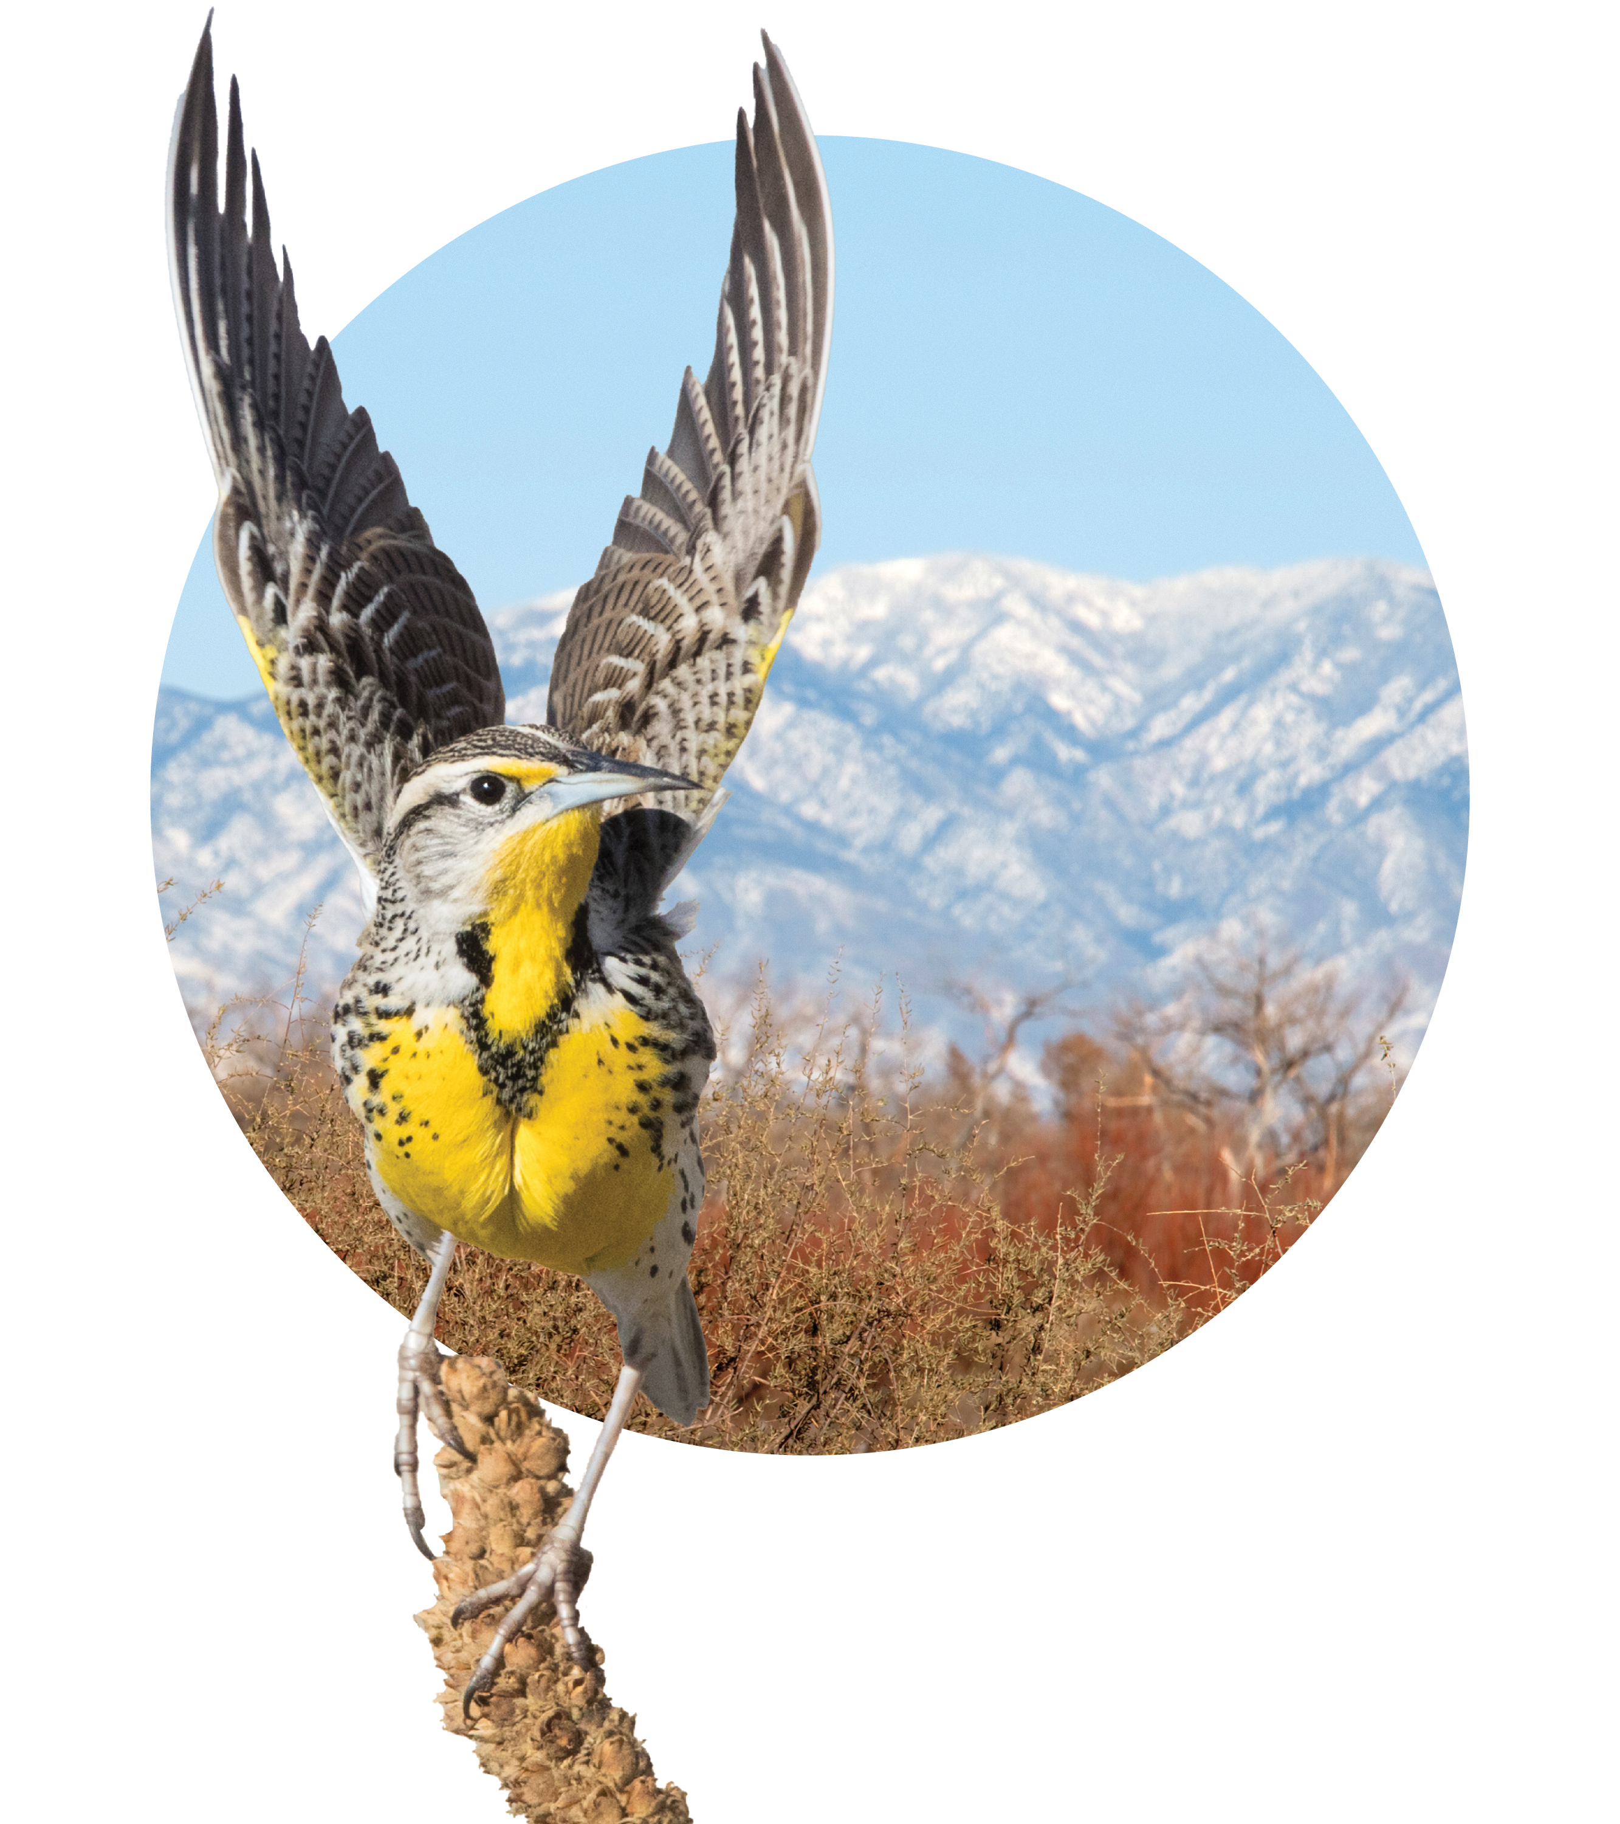
Bird-Friendly Building Ordinances & the City of Chicago
Bryan Lenz, Ph.D.
Glass Collisions Program Director
Bird City Network Director
Photo: Western Meadowlark by Richard Goluch, Shutterstock; Habitat panaroma by Jacob Spendelow

Slide 2
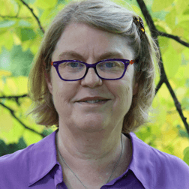
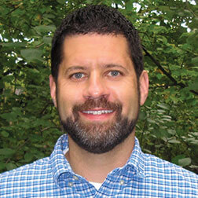
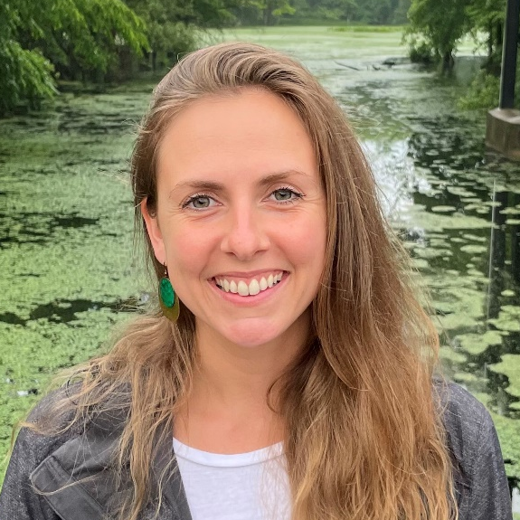
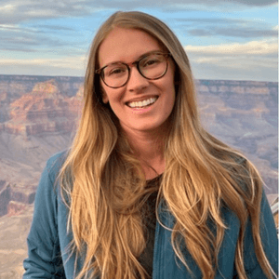
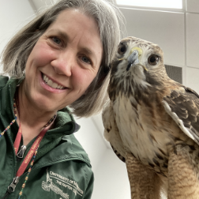
The ABC Collisions Team
Bryan Lenz
Glass Collisions Program Director
Bird City Network Director
Christine Sheppard
Glass Collisions Program Senior Director
Christine Sheppard
Glass Collisions Program Senior Director
Aniko Totha
Glass Testing Program Coordinator
Kaitlyn Parkins
Glass Collisions Program Coordinator
Joanna Eckles
Bird City Network Coordinator
Aniko Totha
Glass Testing Program Coordinator
Kaitlyn Parkins
Glass Collisions Program Coordinator
Joanna Eckles
Bird City Network Coordinator

Slide 3
How Does the ABC Collisions Team Save Birds?
Change the conversation
Tunnel testing & product rating (Threat Factors)
Research
Outreach, education, & empowerment
Consulting: New construction & retrofits
Bird-friendly building design laws & guidelines

Slide 4
Birds Are Good for Chicago…
Environment & sanitation
People love them
– 16% of Illinoisans 2.03 million people (USFWS, 2013)
Economic impact
USFWS (2024)

Slide 5
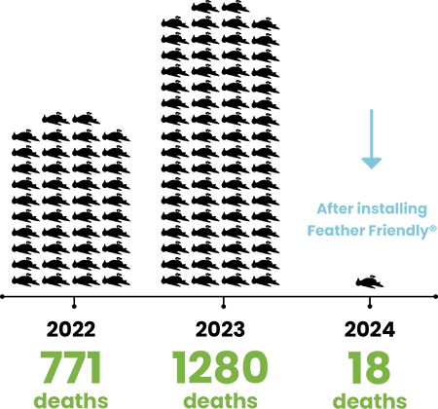
…Chicago Can Be Better for Birds
Feather Friendly (2025)
Great green spaces already!
Among most dangerous cities for birds
Change is happening:
McCormick Place
Feather Friendly: 11 projects done/in progress, 12 conversations

Slide 6
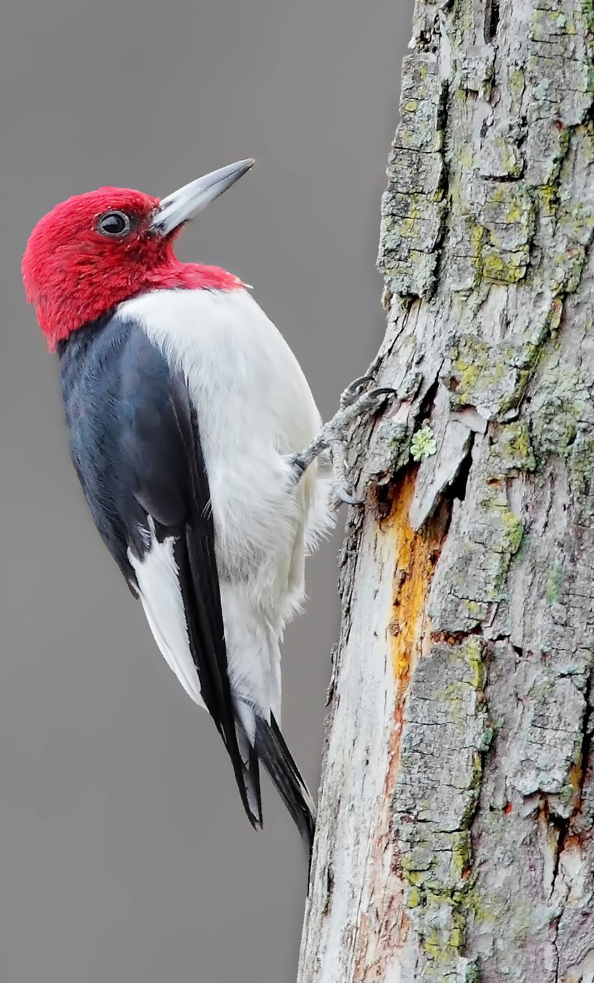
2 Targets
New construction
Existing buildings
2 Pathways
Glass Lighting
Now
Next?
Red-Headed Woodpecker
by Dan Behm

Slide 7
Bird-Friendly Building Ordinances
You don’t have to be first!
Alameda, California (USA)
Arlington, VA (USA)
Cook County, Illinois (USA)
Cupertino, CA (USA)
Emeryville, California (USA)
Evanston, IL (USA)
Highland Park, Illinois (USA)
Howard County, Maryland (USA)
Illinois (State) (USA)
Madison, Wisconsin (USA)
Maine (State) (USA)
Maryland (State) (USA)
Middleton, Wisconsin (USA)
Minneapolis, Minnesota (USA)
Minnesota (State) (USA)
Mountain View, California (USA)
New York City, NY (USA)
Oakland, California (USA)
Portland, Oregon (USA)
Richmond, California (USA)
San Francisco, California (USA)
San Jose, California (USA)
Santa Cruz, California (USA)
Toronto, Ontario (Canada)
Washington, DC (USA)
Wisconsin (State) (USA)

Slide 8
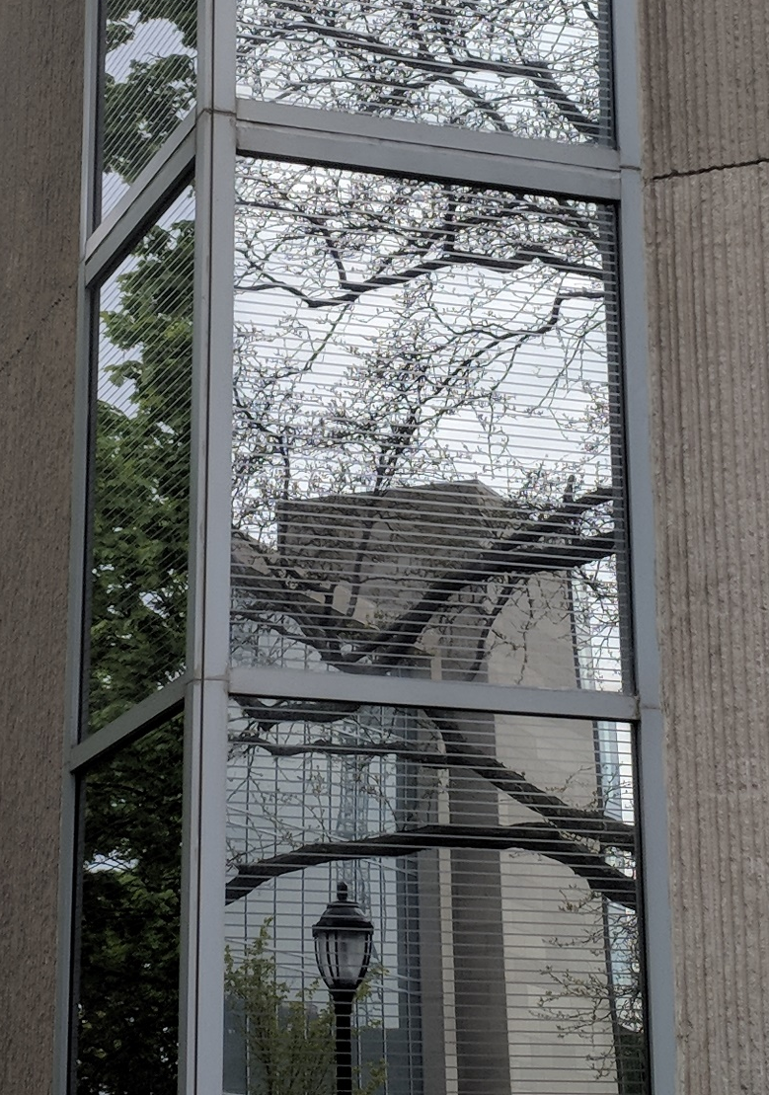
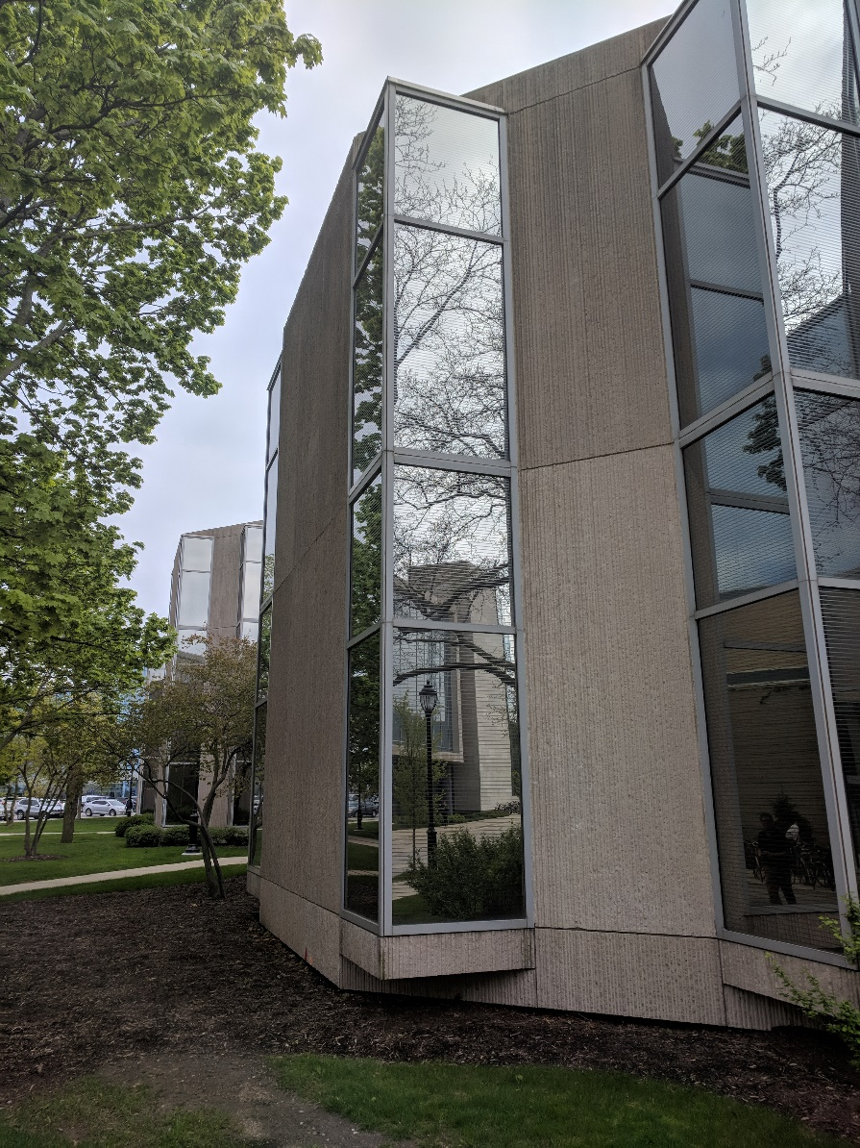
Ordinance Goals
Clear & achievable
Apply to as many buildings as possible
Maximize bird-friendly glass… Where it counts!
Include glass replacement
Avoid unintended consequences
Francis Searle Building, Northwester University, Chicago (Credit: Bryan Lenz)

Slide 9
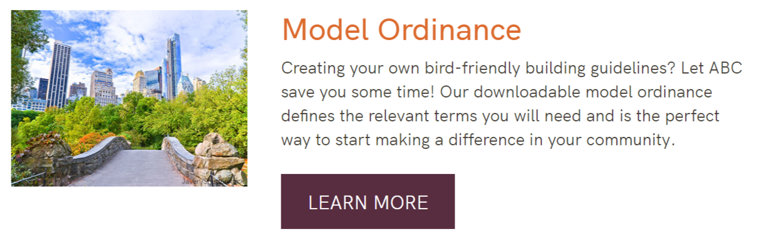
Starting Point: The ABC Model Ordinance
100/100/100
Excellent definitions section

Slide 10
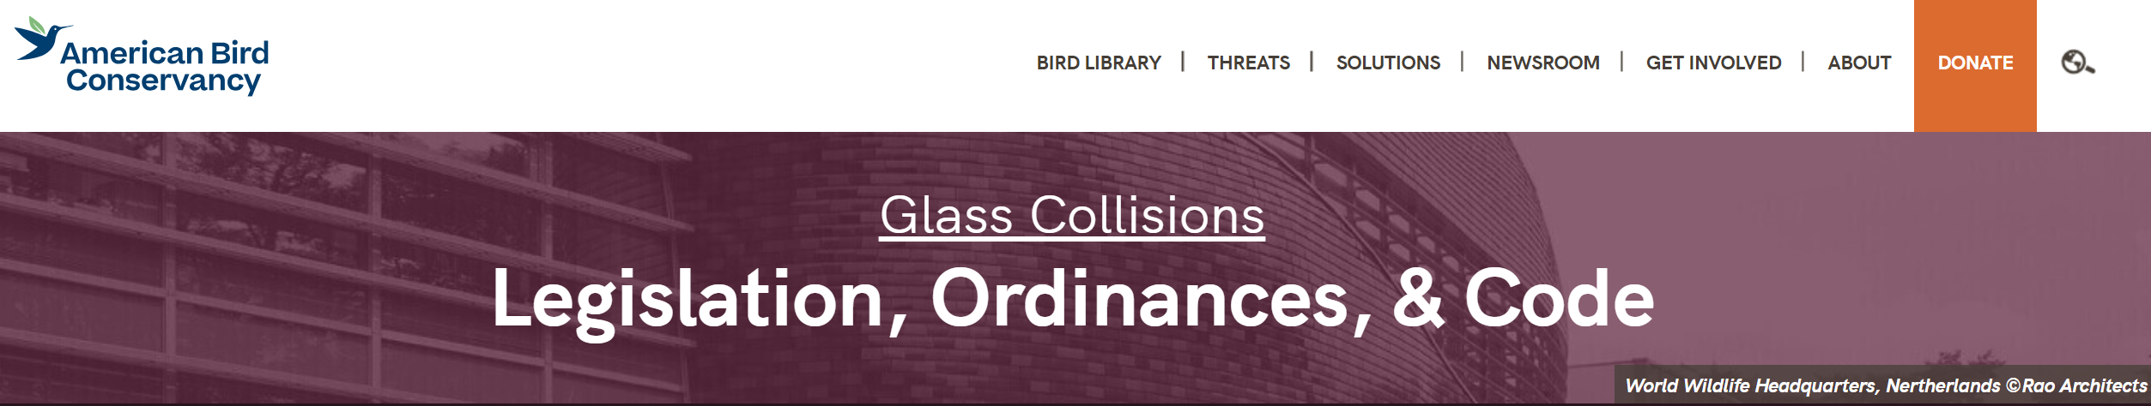
ABC’s Ordinance Tools
https://abcbirds.org/glass-collisions/legislation/
ABC Model Ordinance
Things to consider when editing the model
Review of existing laws

Slide 11
The ABC Team Is Here to Help!
ABC has helped draft many ordinances & would love to work with the City of Chicago and your partners
Thank you to the Chicago City Council to for addressing this critical conservation issue, your constituents will appreciate your actions and so will the birds.
Bryan Lenz, Ph.D.
Glass Collisions Program Director
blenz@abcbirds.org
www.birdsmartglass.org

