Slide 1


Sustainable Data Centers Working Group Recommendations
Committee on Environmental Protection and Energy
July 13, 2026

Slide 2
Agenda
Introduction
Brief Overview
Data Centers Overview
Sustainable Data Centers Working Group
Recommendations

Slide 3
Agenda
Introduction
Brief Overview
Data Centers Overview
Sustainable Data Centers Working Group
Recommendations

Slide 4
Brief Overview: Problem
Data centers in Chicago are rapidly increasing in size & number.
Data centers have significant impacts that are felt acutely by surrounding communities.
Our regulations do not reflect the realities of modern data centers.
Notes:
Data centers in Chicago are projected to increase in size & number: Rise in AI demand; water, energy, labor, and fiber optic resources in Chicago.
Data centers have large externalities: noise, rising energy prices, grid instability; local air pollution; greenhouse gas emissions.

Slide 5
Brief Overview: Process
Sustainable Data Centers Working Group met monthly from January 2025 – June 2026.
Interdepartmental group & consulted representatives from nearly 50 organizations.
Recommended policies that address environmental, energy, and community impacts of data centers.

Slide 6
Brief Overview: Recommendations
Strong Environmental Safeguards
Responsible Zoning & Land Use
Transparent Data Reporting & Accountability
Notes:
1: Strong Environmental Safeguards 2. Responsible Zoning and Land Use 3. Transparent Performance and Accountability

Slide 7
Agenda
Introduction
Brief Overview
Data Centers Overview
Sustainable Data Centers Working Group
Recommendations

Slide 8
Data Centers Overview
A facility that houses computing equipment used to store, manipulate, or process digital information.
A data center may be a stand-alone facility or part of a mixed-use building.

Slide 9
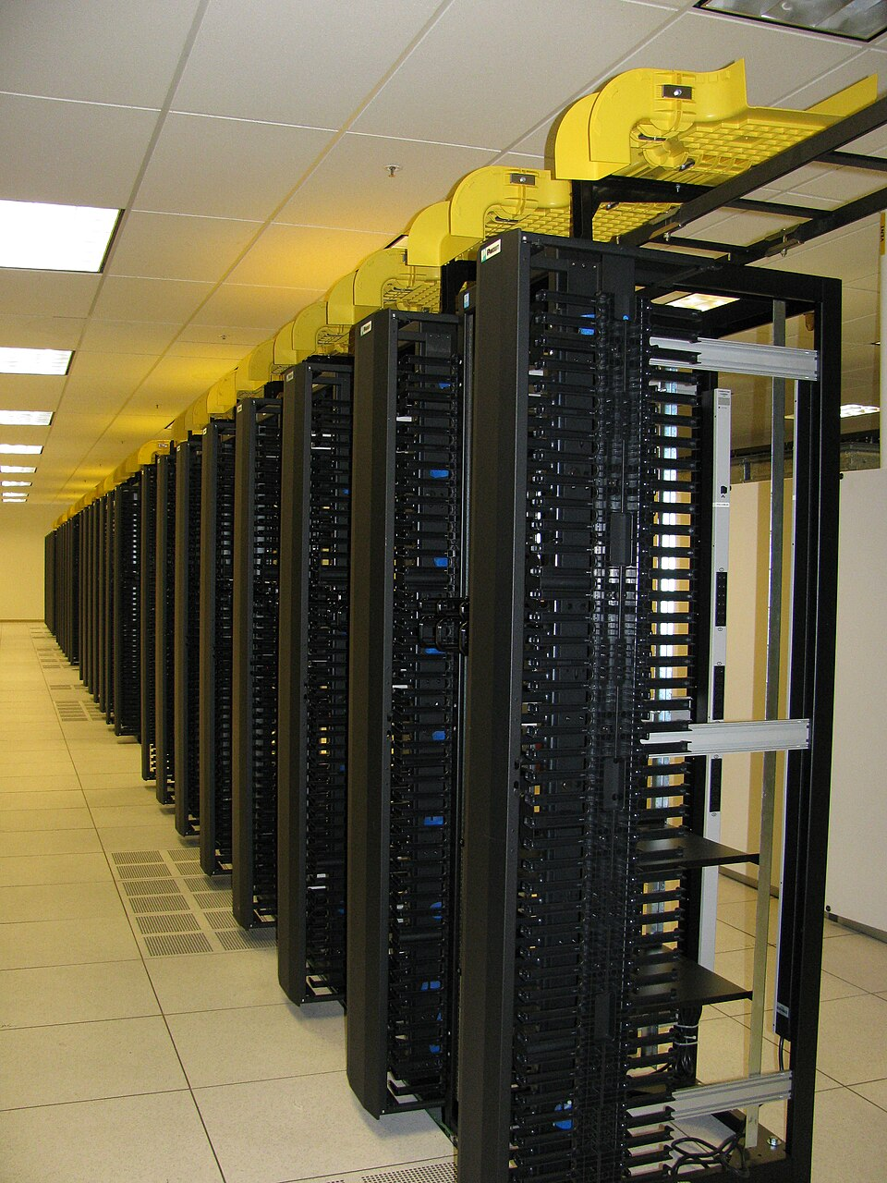
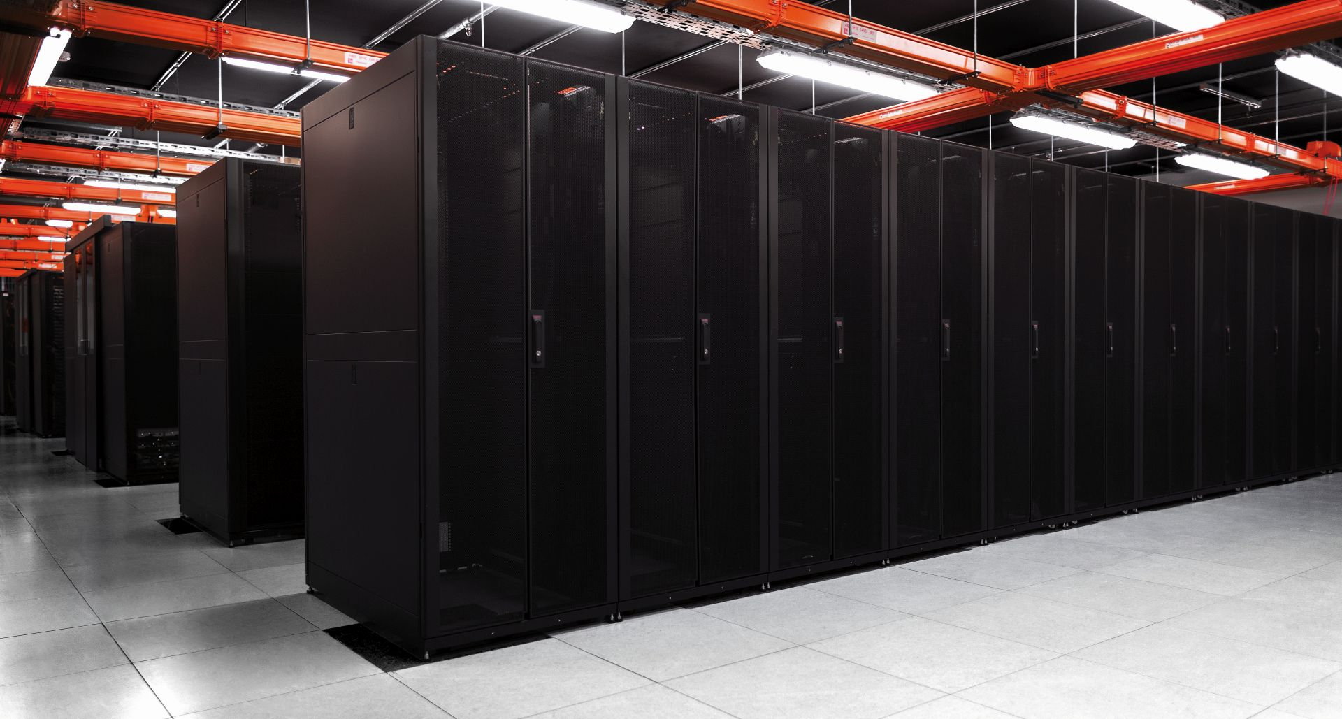
Image credit: By Virtuo Doc, Wikimedia Commons
Image credit: Robert.Harker,
Wikimedia Commons

Slide 10
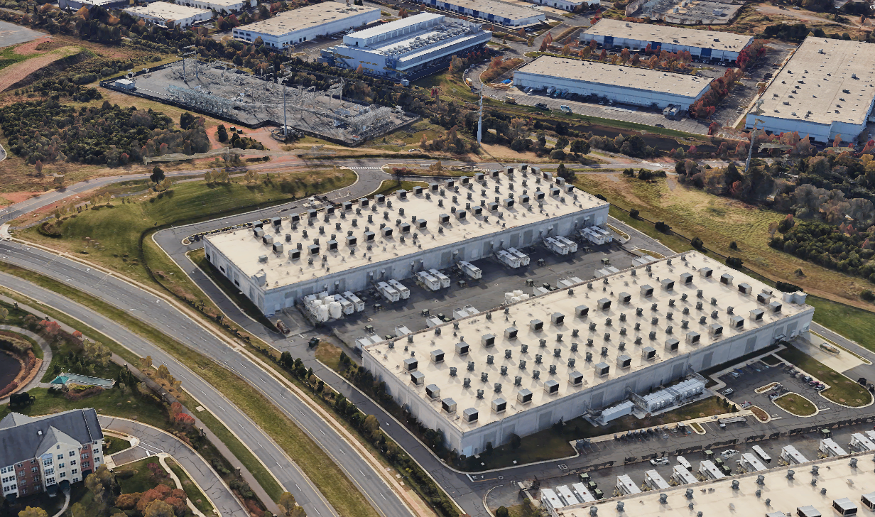
Image credit: Google Maps

Slide 11
Image credit: Google Maps

Slide 12
Image credit: Google Maps

Slide 13
Image credit: Google Maps

Slide 14
Image credit: Google Maps

Slide 15
Image credit: Google Maps

Slide 16
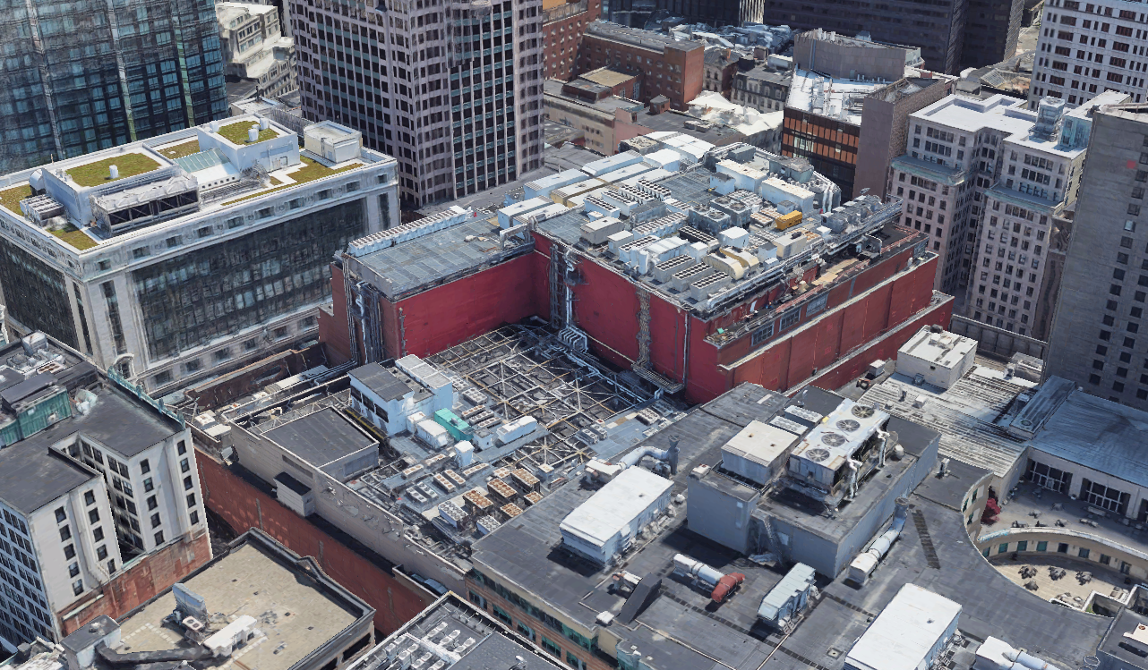
Image credit: Google Maps
Notes:
Boston – highlight density and proximity to neighbors

Slide 17
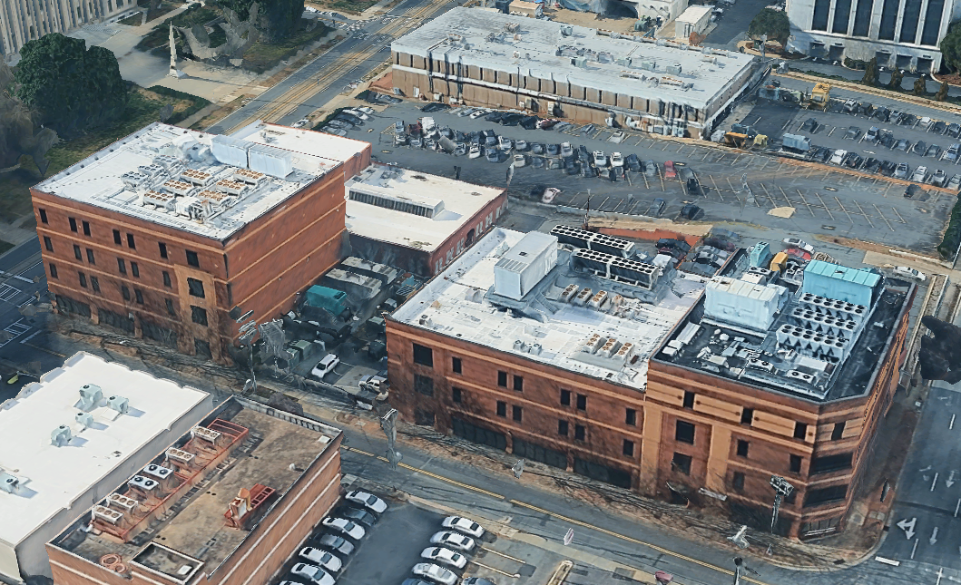
Image credit: Google Maps
Notes:
Charlotte – highlight lot between buildings (ground-level generators)

Slide 18
Why Chicago for data center development?
Proximity of users
  High speed of service
Access to infrastructure
  Fiber optic network, water, electricity
Highly skilled workforce
  Construction and operation

Slide 19
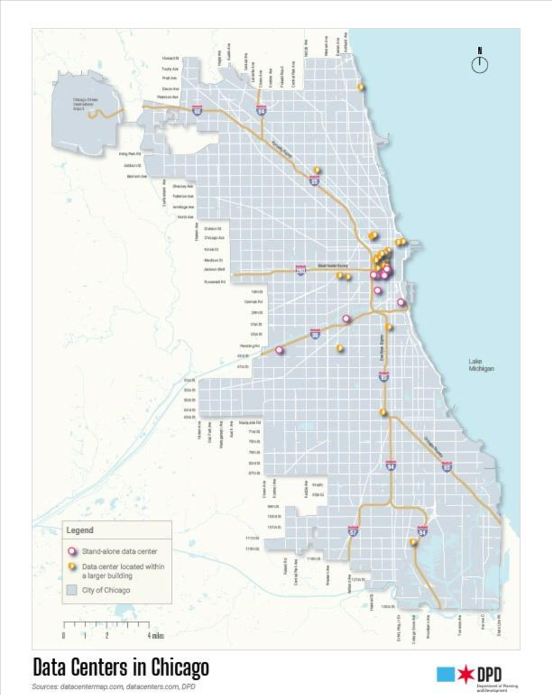
Where are data centers located?
Centrally located or near utility corridors
Mostly colocation or enterprise data centers
Chicago’s land use patterns and population density require thoughtful policy solutions

Slide 20
How are data centers currently regulated in Chicago?
“Electronic Data
Storage Center”
Permitted by-right:
  All commercial districts
  All manufacturing districts
  Some business districts
Source: Department of Planning and Development

Slide 21
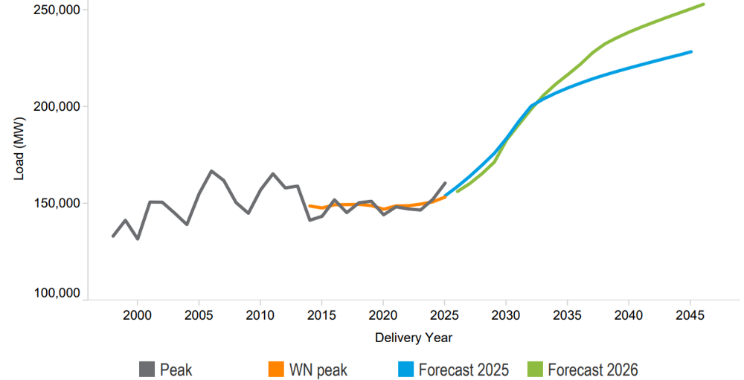
Impacts: Energy
Observed and projected peak electricity demand in the PJM region
Demand-driven price increases
Increased grid instability
Increased GHG emissions
Source: PJM Interconnection, 2026 PJM Load Forecast Report

Slide 22
Impacts: Air and Sound Pollution
Significant noise pollution:
  24-hour sound from HVAC systems
  Generator testing (required monthly)
Significant air pollution:
  Diesel emissions from generator testing and emergency use
Most Chicago data-center-related 311 complaints are due to noise & air pollution.

Slide 23
Impacts: Water
High water usage for cooling
  Varies by cooling system and facility
    Average is 300,000 gallons water / day, which is equivalent to 1,000 households' usage
No requirements for water usage transparency

Slide 24
Agenda
Introduction
Brief Overview
Data Centers Overview
Sustainable Data Centers Working Group
Recommendations

Slide 25
Process Timeline
City ordinance
September 2024
Monthly Meetings Begin
January 2025
Release of Data Centers Report
July 2026
Industry Roundtable
April 2026
Environmental Protection & Energy Committee Hearing
May 2026
Community Meeting
July 2026

Slide 26
Departments in Working Group
  Environment
  Planning and Development
  Public Health (Environmental Permitting and Inspections, now DOE)
  Technology and Innovation

Slide 27
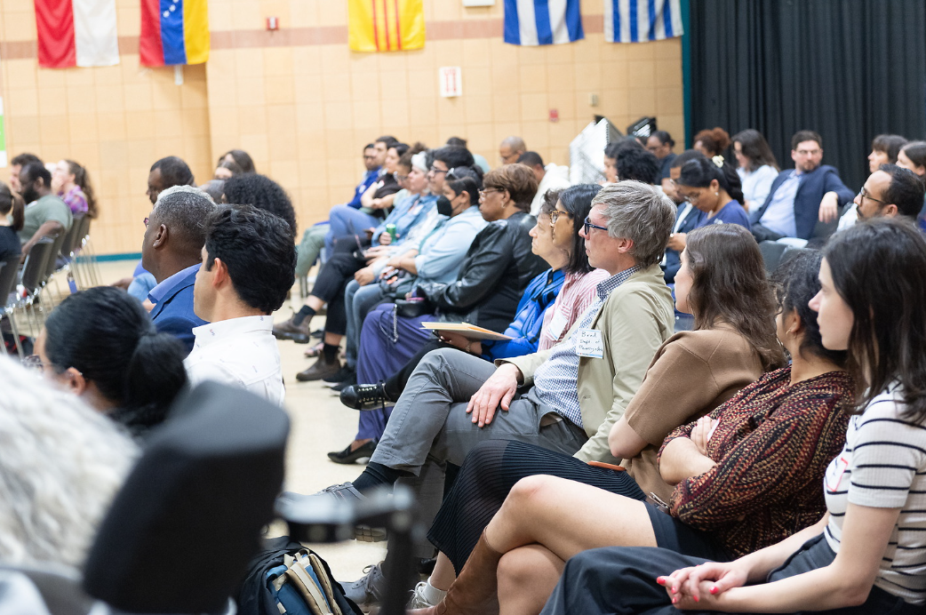
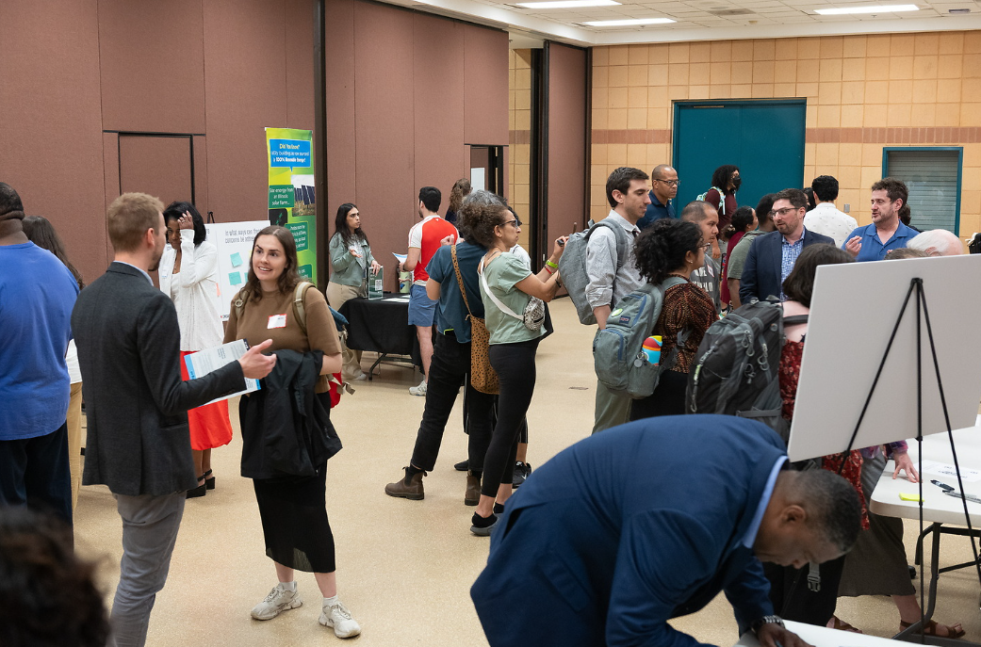
Outreach
Direct engagement with ~50 organizations
Industry roundtable
Public meeting

Slide 28
Public Meeting Results
Resident priorities for action:
  Air quality
  Sound
  Environmental justice
  Water
  Transparency
Support for regulations on data centers

Slide 29
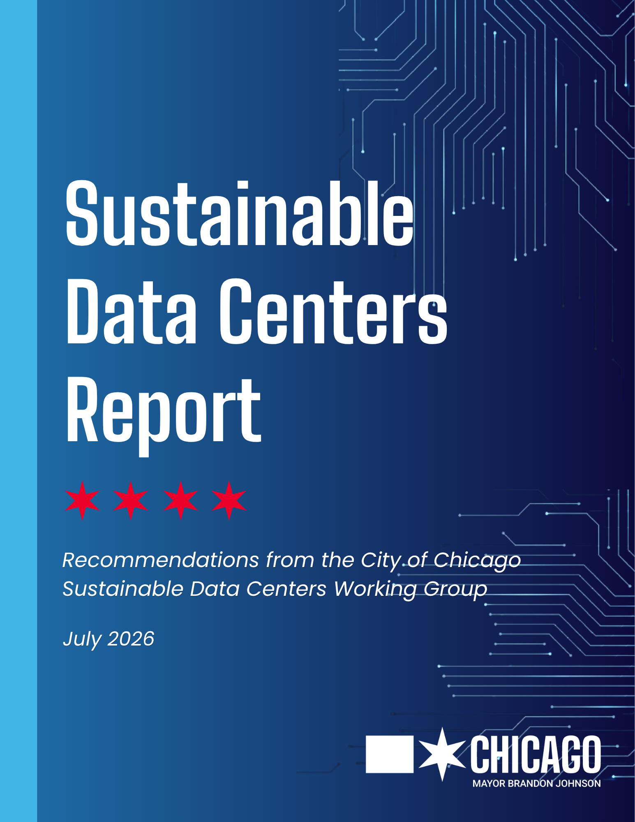
Agenda
Introduction
Brief Overview
Data Centers Overview
Sustainable Data Centers Working Group
Recommendations

Slide 30
Recommendations
Strong Environmental Safeguards
Responsible Zoning & Land Use
Transparent Data Reporting & Accountability

Slide 31
Strong Environmental Safeguards
Environmental safeguards should:
Protect residents from air & noise pollution
Apply to new and existing facilities
How: Enhanced environmental permitting process
Notes:
Local environmental impacts are a major source of resident complaints

Slide 32
2. Responsible Zoning & Land Use
Zoning & land use processes should:
Address the impacts of modern data centers
Focus on use standards, siting, thresholds, sustainable development requirements, community engagement requirements, and more.
How: Zoning Code Amendments

Slide 33
3. Transparent Data Reporting & Accountability
Data reporting approach should:
Require all data centers to annually report electricity and water consumption
Increase transparency to inform future policy
How: Amendment to Chicago Energy Benchmarking Ordinance

Slide 34
Topics for Continued Action
Industrial water rates
Water reuse
District energy / waste heat reuse
Community benefits
Additional regulatory improvements

Slide 35
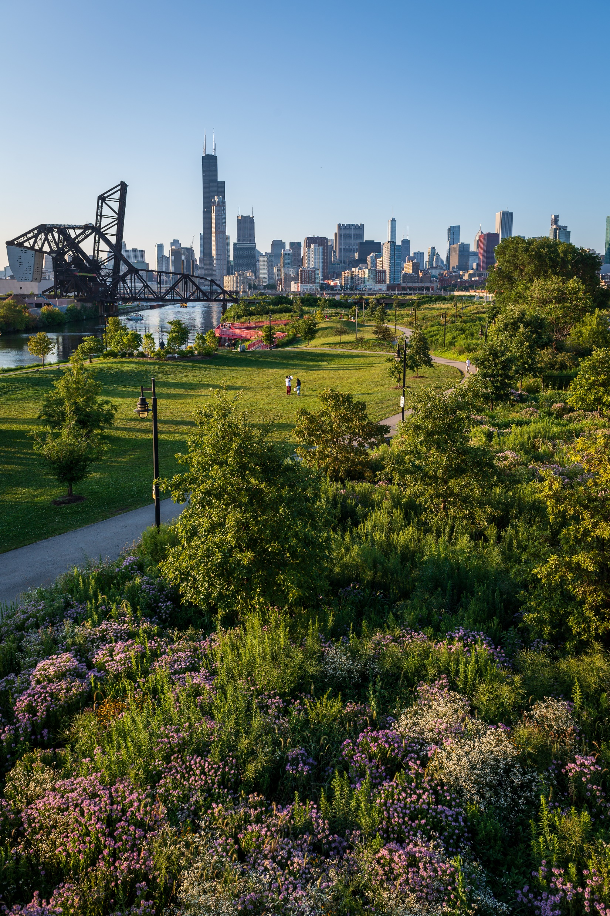
Acknowledgements
Department of Environment:
Angela Tovar
Jared Policicchio
Jared Patton
Dave Graham
Michael Enos
Jackie Rigley
Avigail Bailon
Lindy Wordlaw
Department of Planning and Development:
Bradley Roback
Jeffrey Cohen
Lisa Thomas
Department of Technology and Innovation:
Deborah Anderson
Andre Johnson

